Slide 1
X-Road Central Infrastructure Setup and Operation
… Continuation

Slide 2
Agenda
Breaks will be arranged according to the tempo. We try to have a break at least after 1.5h or work..
1
Member management
2
Operation and governance of ecosystem
3
MISP setup practice
4
Q&A
5
Test

Slide 3
Disclaimer
Training scope is related to the scope of the project (structured into several pieces of training).
This is training for trainees - what you need to learn we do our best to deliver it.
Based on trainee activity the duration of the training is reasonably flexible in both directions.
During the project the training is covered by a warranty for trainees - you can bring up a topic touched in the training during warranty to ask for clarifications.
A training is best source for new knowledge - this is also tested at the end.
To become an expert you will need to put all you have learnt into constant practice.
Using X-Road instance “roksnet-dev” and related components for practices.

Slide 4
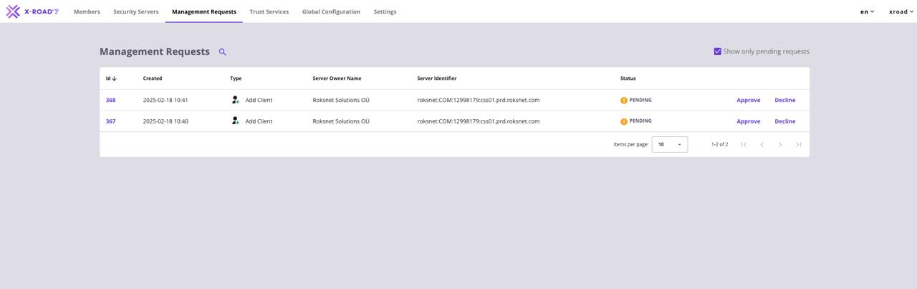

Member Management
What does it mean?
Adding security server
Adding member
Adding sub-system

Slide 5
Member Interactions
CA
Security Server
Central Server
Sign CSR
AuthCertReg
Signing AUTH CSR
Signing SIGN CSR
Auth Cert Reg
Client Registration
Member
Subsystem
Just accepting all management requests?
Member Management Process
ClientReg (member & subsystem)
Global Configuration

Slide 6

Member Management
Just accepting all management requests?
Just accepting all management requests?
Joining compliance / Who are the clients?
TM-DEV
TM-TEST
TM
suspension /removal process

Slide 7

CRM
X-Road central server is not your CRM
Where will you:
Keep member contact details?
Store contract (if relevant)
Compliance issue tracking?

Slide 8

Operation
Team
Monitoring
SLA

Slide 9

Operator Team
Team Lead
Evangelist / Architect / Trainer of APIs
Service owner (X-Road)
Member manager
Infrastructure operator / Sysadmin
Monitoring expert (when relevant)
(Support)
Sub-team (to break off later):
PKI Service owner
CA operator
In the beginning: appoint dedicated persons for a client

Slide 10
Monitoring
Java Application / Not X-Road Specific Monitoring
Security Server is yet another java application
X-Road processes must be running
Application must have enough resources
Finding issues before they become problems is important for a stable ecosystem.
Relevant protocols:
PR-OPMON
PR-OPMONJMX (disabled by default)
PR-ENVMONMES
Component Governance / Environmental Monitoring
What protocol versions and feature set is used by members?
Are members maintaining technical components?
API Governance / Operational Monitoring
Who are biggest stakeholders?
How members depend on each-other? Relationships and dependency?
How to stick API responsibility to owners?

Slide 11

Helping new and existing members
Initiating and facilitating new integrations between members.
Questionnaire of this project as content guide for facilitation.
Routine help questions about X-Road, service etc.
Help debugging Members problems with their Security Servers or APIs/services.

Slide 12

Questions?

Slide 13

MISP
Mini Information System Portal

Slide 14
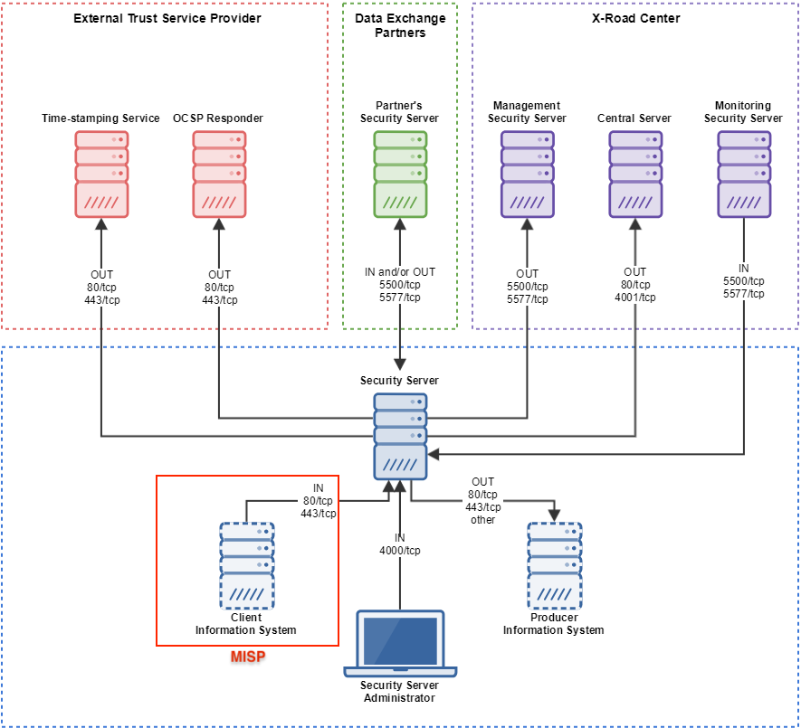
Overview
Overview and architecture
The MISP portal of-the-shelf component for X-Road members.
Key function: end-user ability to execute request as consumer without development.
Temporary or emergency usage.
Developer validation tool.
Notes:
The MISP2 portal is a pre-made X-Road component, that allows a user to generate and take into use user interfaces for X-Road services, without the need to develop special software.
The target user group for MISP2 are the institutions that need to start using X-Road services, but for who it is not yet allocated resources to develop support for X-Road in their existing software solutions.

Slide 15
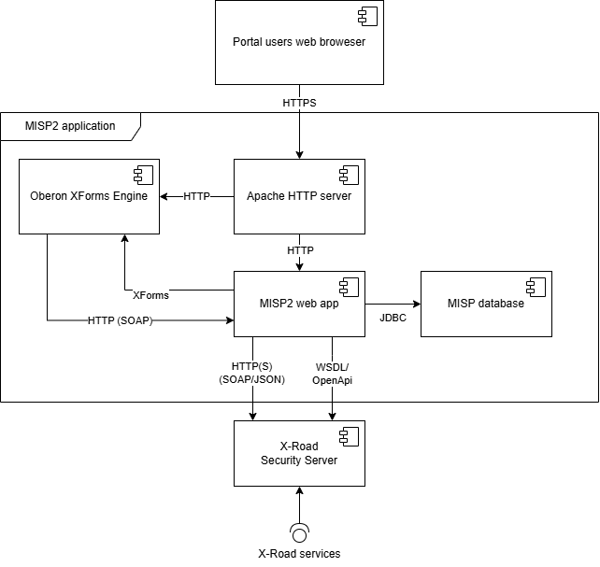
Architecture
Overview and architecture
The standard components of MISP are:
The MISP webapp
The Orbeon XForms engine
The MISP database
The Apache HTTP server
Apache Tomcat

Slide 16
MISP components
Overview and architecture
MISP webapp
The main function of the webapp is to server as the main place to generate and use user interfaces based on X-Road services as well as handling authentication and user rights management.
The Orbeon XForms engine
MISP uses the XForms standard in order to define input and output forms for X-Road SOAP services.
The Apache HTTP server
handles HTTPS communication and proxies client requests to the MISP application running in the backend.
The MISP database
Information about the portals users and their groups, metadata about X-Road producers, metadata about services, including generated forms, information about query access rights.

Slide 17
Requirements for the environment
Setup
Supported operating system: Ubuntu Server 22.04 Long-Term Support (LTS), 64-bit.
Supported Java version: 8
Needs connection with an X-Road Security Server (internal interface), which has an X-Road setup in place; MISP operates through X-Road.
Recommended hardware requirements: 64-bit processor, 4 GB of RAM

Slide 18
MISP
misp1.dev.roksnet.com
misp2.dev.roksnet.com
misp3.dev.roksnet.com
misp4.dev.roksnet.com
misp5.dev.roksnet.com
SSH user: training
SSH password: training
Installing and configuring MISP into a clean VM.

Slide 19
Preparing the environment
Setup
Add package repositories:
sudo nano /etc/apt/sources.list.d/misp.list
# Add MISP repo
deb [trusted=yes] http://10.222.0.200/misp jammy main
Update package list
sudo apt -o "Acquire::https::Verify-Peer=false" update

Slide 20
MISP database package
Setup
The MISP2 database package xtee-misp2-postgresql is installed with default settings using the command:
sudo apt-get -o "Acquire::https::Verify-Peer=false" install xtee-misp2-postgresql
Below is a list of questions and answers displayed after this command is run.
Please provide database name: [misp2db]
Please provide username for accessing database: [misp2]
Enter password for new role:
The default role i.e. username is misp2 and only the password is queried.
For training purposes, use misp2 as password. It is suitable only for training environment.

Slide 21
MISP application
Setup
Install the package xtee-misp2-application.
sudo apt-get -o "Acquire::https::Verify-Peer=false" install xtee-misp2-application
Below is a list of questions and answers displayed after this command is run.
Please provide database host IP to be used [default: 127.0.0.1]:
Please provide database port to be used [default: 5432]:
Please provide database name to be used [default: misp2db]:
Please provide username to be communicating with database [default: misp2]:
Please enter password for database user 'misp2': misp2

Slide 22
MISP application
Setup
Below is a list of questions and answers displayed after this command is run.
Please provide SMTP host address [default: smtp.domain.ee]:
Please provide server email address: [default: info@domain.ee]:
Please provide X-Road v6 instances (comma separated list)? [default: eu-dev,eu-test,eu] TM-DEV, TM
Please provide X-Road v6 member classes (comma separated list)? [default: COM,EXT,GOV]

Slide 23
MISP application
Setup
Admin account registration:
Do you want to add new administrator account? [y/n] [default: y]
Enter new administrator username > mispadmin
Enter password > mispadmin
Allow access from hosting machine and disable HTTPS connection between MISP and Security server:
Please provide IP address(es) allowed to access administrator interface (separated by space): [default: xx.xx.xx.xx] all
Do you want to enable HTTPS connection between MISP2 application and security server? [y/n] [default: n] n

Slide 24
MISP Application Localization
Configuration
To change country to TM and enable password authentication, at least for during the training, it is necessary to edit:
sudo nano /usr/xtee/app/conf/config.cfg
Change country to TM:
countries = TM
Disable all authentication methods, and enable only password authentication: auth.password=true
auth.IDCard=false
…
Enable custom ui banner:
ui.pemu=true

Slide 25
MISP Administrator Accounts (command line utility)
Configuration
The list of existing administrator accounts
/usr/xtee/app/admintool.sh
Add the -add parameter to the command line to add an administrator account:
/usr/xtee/app/admintool.sh -add
Add the -delete parameter to the command line to delete the administrator account: /usr/xtee/app/admintool.sh -delete

Slide 26
MISP admin web UI access
Configuration
Command line util for managing access
sudo /usr/xtee/app/configure_admin_interface_ip.sh
Or manually changing Apache configuration
sudo nano /etc/apache2/sites-available/ssl.conf
Find and edit. Add the address of your own computer <Location> to the end of the line, e.g.:
<Location "/*/admin/*">
Order deny,allow
Deny from all
Allow from 127.0.0.1 192.168.3.9
</Location>
Restart the web server
sudo systemctl restart apache2

Slide 27
MISP Application Installation (if there is an error)
Configuration
Due to an issue with Tomcat 9 and JAVA8 on Ubuntu 22.04, the following additional steps need to be taken:
sudo apt install libecj-java
sudo ln -s /usr/share/java/ecj.jar /var/lib/tomcat9/lib
sudo systemctl restart tomcat9

Slide 28
MISP Application HTTPS Configuration (Optional)
Configuration
To change the connection between the Security Server and the backend service to HTTPS, follow these steps:
Upload the Security Server's TLS certificate to the MISP server.
Upload the MISP server's TLS certificate to the Security Server.
Change the client connection type to 'HTTPS'.
Adjust the portal to use the Security Server's HTTPS endpoint

Slide 29
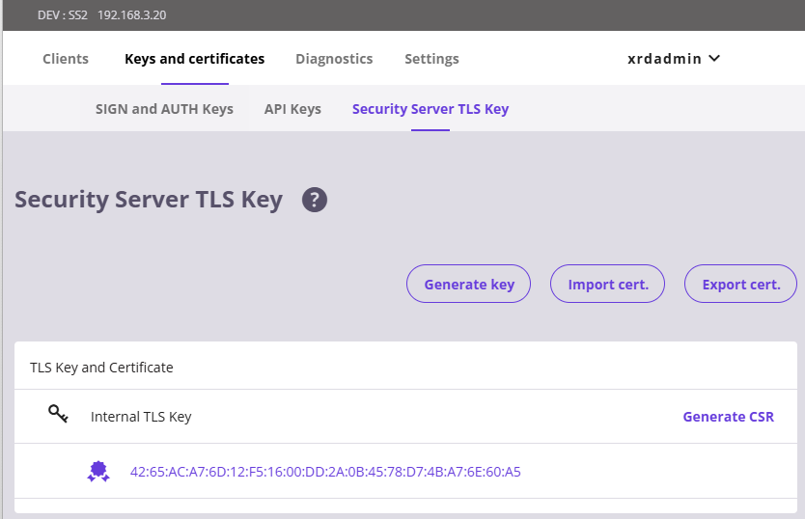
MISP Application HTTPS Configuration
Configuration
Obtain the Security Server's TLS certificate:
Log in to the Security Server Management UI
Navigate to the "Keys and Certificates" tab.
Open the "Security Server TLS Key" subtab.
Export the TLS certificate and save as certs.tar.gz

Slide 30
MISP Application HTTPS Configuration
Configuration
Upload the Security Server's TLS certificate to the MISP server:
Use WinSCP to transfer the file to the /tmp folder on the MISP server.
Use the following command to move the file to its dedicated location:
sudo cp /tmp/ss2.tar.gz /usr/xtee/apache2/certs.tar.gz
Run the configuration script on the MISP2 server
sudo /usr/xtee/app/create_https_certs_security_server.sh
Assign a password to the trust store if prompted.
When adding the Security Server’s certificate, confirm trust when prompted.
Trust this certificate? [no]: yes
Get '/usr/xtee/app/cert.cer' to your local machine.

Slide 31
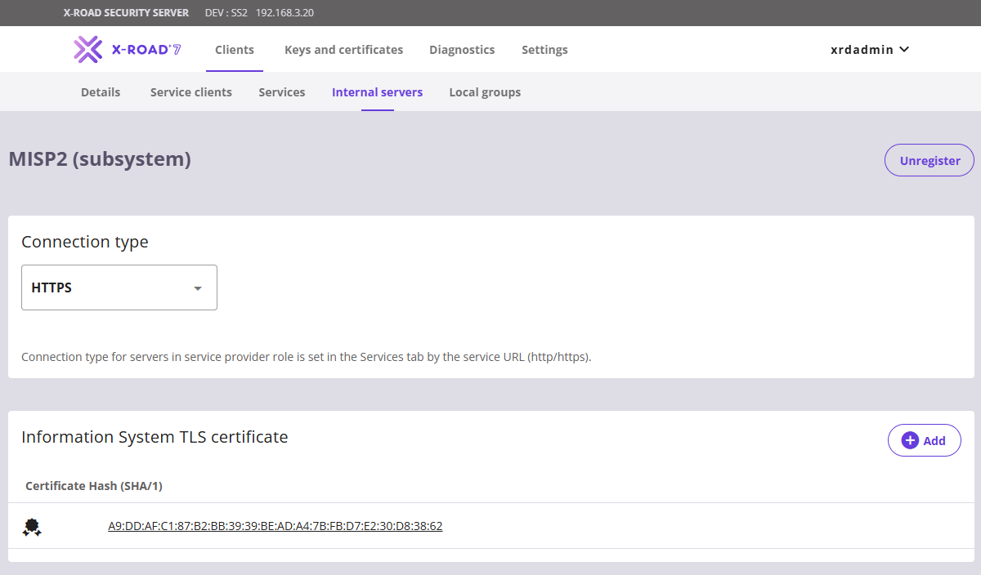
MISP Application HTTPS Configuration
Configuration
Upload the MISP server's TLS certificate to the Security Server:
Log in to the Security Server Management UI
Navigate to the "Clients" tab.
Select the 'MISP' subsystem from the clients list.
Go to the 'Internal Servers' subtab.
Add MISP certificate to Information System TLS certificate
Change Connection type to HTTPS

Slide 32
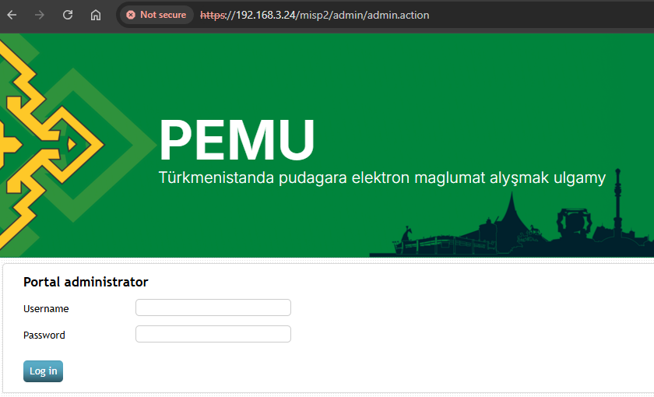
MISP Ready
Administration
Open https://<server address>/misp2/admin/ in a browser. If the homepage is visible, then the setup phase is complete:

Slide 33
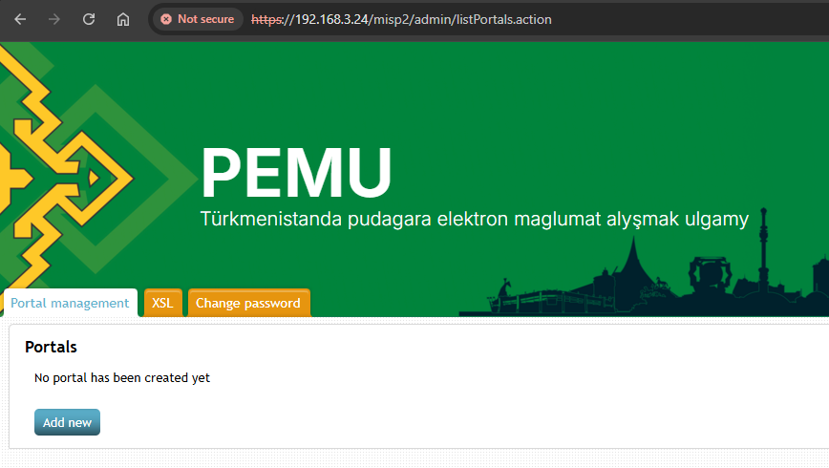
Administration Panel
Administration
Enter admin credentials:
Username: mispadmin
Password: mispadmin
The administration landing page should be visible now.
Add a new portal.

Slide 34
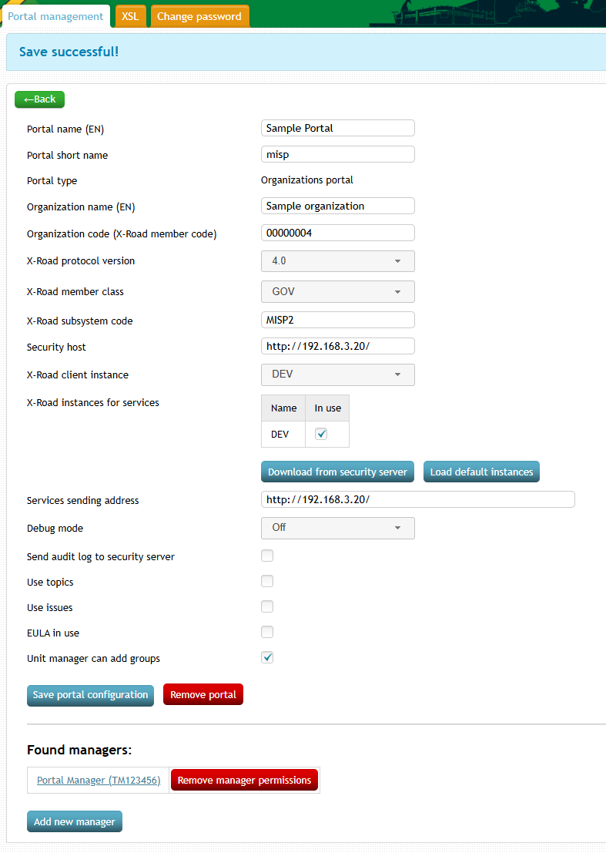
Administration Panel
Administration
Enter the Security Server's host IP in the portal form.
Use HTTP endpoint if HTTPS was not configured
Using HTTPS is recommended.
Click 'Download from Security Server'.
If the instance table updates with the X-Road instance name from the Security Server, the MISP installation is complete and connected to the Security Server.

Slide 35
Questions?

Slide 36

Test
20 questions
70% to pass
lms.xroad.gov.tm
Course: X-Road Central Infrastructure Setup and Operation (feb 2025)
Open until midnight February 19th.

Slide 37
Good luck with starting up with your platform!
Thank you!
Pictiures from https://pixabay.com/ or private collection or cenerated with Gemini AI.

