Slide 1
X-Road Central Infrastructure Setup and Operation

Slide 2
Agenda
Breaks around 11.a.m. and 1.p,m.. As we have a lot to cover… lets see how time goes.
1
Components and Interfaces
2
Setup and initial configuration
3
Member management with practice
4
SLA, Operation and Maintenance
5
Governance and Community
6
Test

Slide 3
Disclaimer
Training scope is related to the scope of the project (structured into several pieces of training).
This is training for trainees - what you need to learn we do our best to deliver it.
Based on trainee activity the duration of the training is reasonably flexible in both directions.
During the project the training is covered by a warranty for trainees - you can bring up a topic touched in the training during warranty to ask for clarifications.
A training is best source for new knowledge - this is also tested at the end.
To become an expert you will need to put all you have learnt into constant practice.

Slide 4
Introductions
Nortal team
Aragatnashyk team
Heiko Vainsalu
Integrator/developer in public sector
X-tee domain manager in RIA
Consultant of interoperability and e-Governance
eGov guest lecturer at TalTech
Riho Hiiepuu
X-Road operator, developer, consultant
Full-Stack developer
PKI expert
Who you are?
Current position/role?
Experience with X-Road?
Expectations for the training?
What will be your most critical expectation today?

Slide 5
Overview: Components & Interfaces
Notes:
22.3 X-Road central infrastructure setup and operation (5 persons) 43
22.4 Security Server Setup and Operation (25 persons!) 44
22.5 Service design for X-Road context (15 persons!)

Slide 6
Idea
Governing Authority
Configuration
& Trust
Information System Owner
Secure Data Exchange
Evidence
Information System Owner

Slide 7
Data Exchange
Keep this effective
Organisation A, B, ...
Organisation A, B, ...
Security Server
Secure Exchange of Data
Security Server
Keep this simple
Information System
Information System
Operator
X-Road Central Components

Slide 8
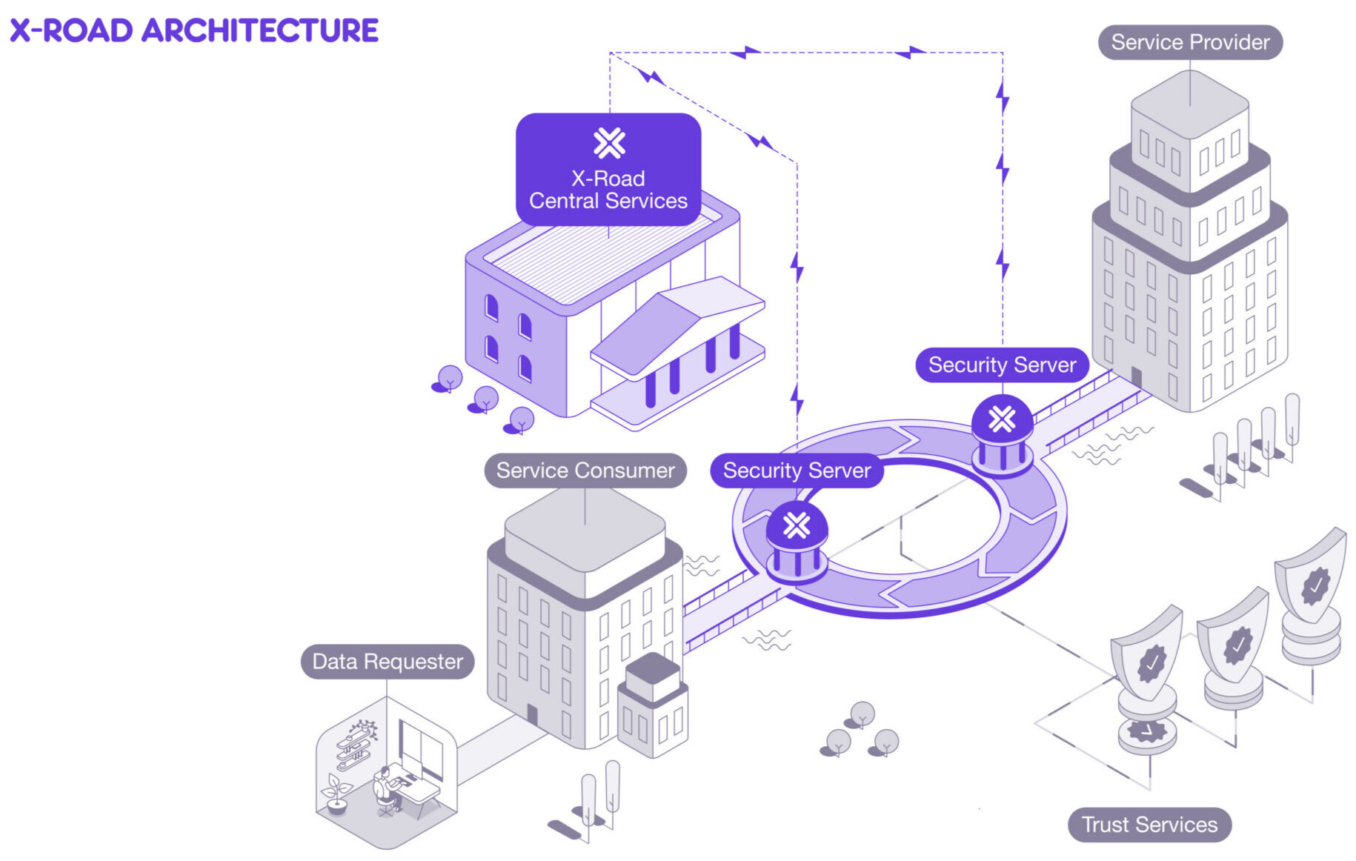
Main Components of X-Road ecosystem
Central Server
Security Server
Timestamping Authority
Certification Authority
X-road.global / niis.org

Slide 9
All Components
CP
CS
Mng. SS
Monitoring
MISP
Red - core X-Road
Green - core member
Brown - optional X-Road
Gray - External and custom
(Consumer) SS
(Provider) SS
Provider I.System
Consumer I.System
CA/OCSP
TSA
Catalogue

Slide 10
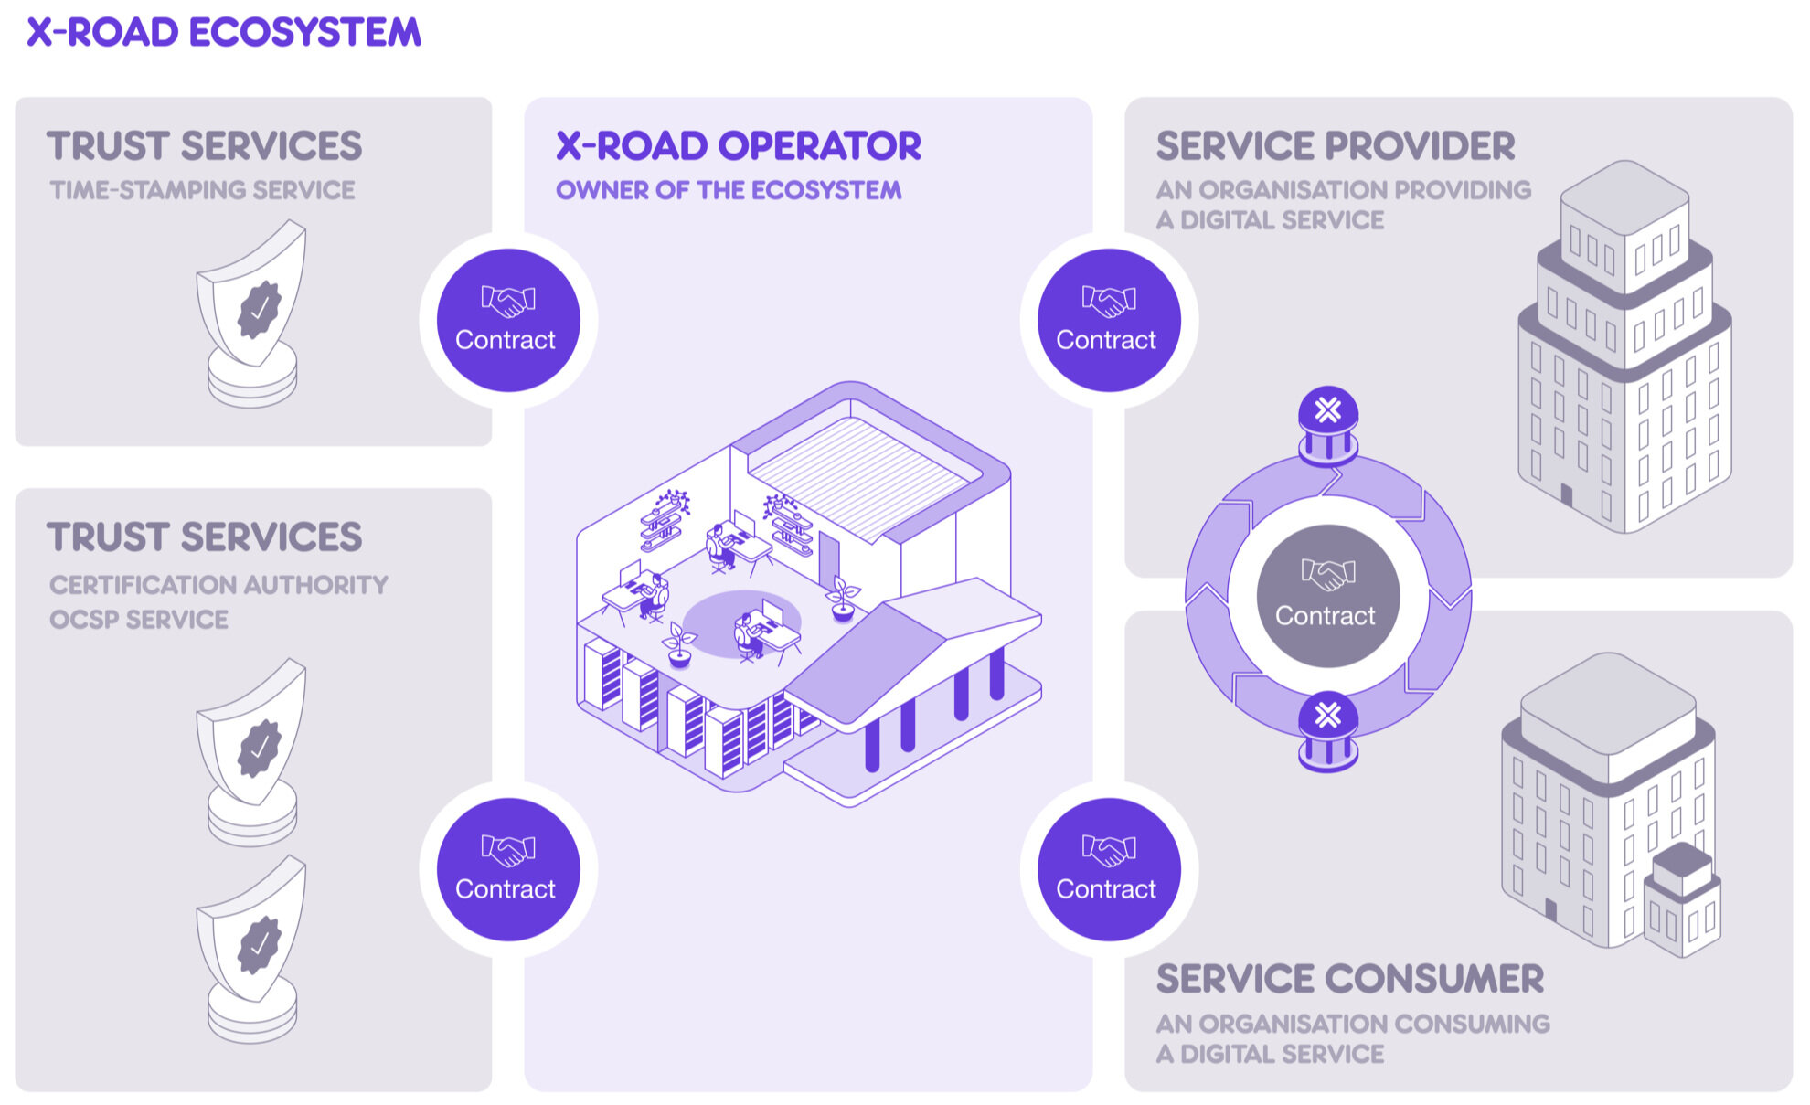
Function of the X-Road Center
Members
Security Servers list
PKI settings
Phonebook
X-road.global / niis.org

Slide 11
X-Road Operator Components
(PKI)
Central Server
Management Security Server
CA
Server authentication certificate
Member digital signature certificate
OCSP
Certificate validity service
TSA
Timestamping server
Member register
Security servers (certified gateways)
Members (certified entities)
Subsystems
Configuration signing and publishing
Pass through for management requests
“Eat your own dog food”

Slide 12
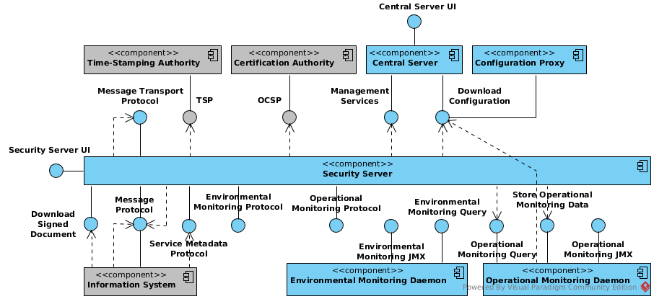
Interfaces

Slide 13

Questions?

Slide 14

X-Road Setup
Preparation for individual practice

Slide 15
After the training…
NIIS has released an update for X-Road.
Home assignment:
Prepare PKI for an isolated X-Road instance setup.
Practice the setup independently from creating VMs to adding first member security server.
You will need to do this upon every release to validate that for you the release is usable for introducing to TM-DEV instance.

Slide 16
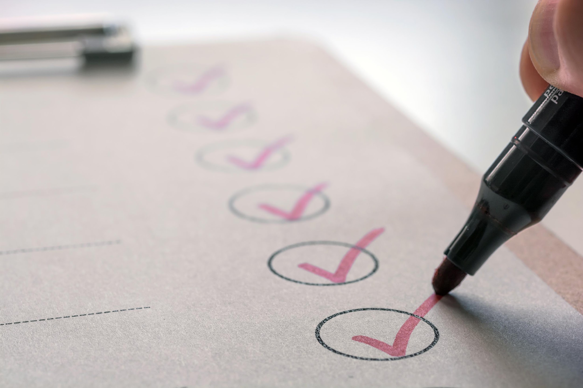
Order of Setup
Central Server
Management Security Server
Member Security Server
R

Slide 17


Central Server practice
How to install Central Server
How to setup Central server

Slide 18
Requirements
Ubuntu 22.04 LTS or Ubuntu 24.04 LTS
Virtual machine with min 2gb ram, 1 cpu and 40gb of hard disk space (mostly for the logs)
Internet connection or access to a internal X-Road repository
Root access to the machine
Additional requirements are available from official documentation (networking etc): https://github.com/nordic-institute/X-Road/blob/master/doc/Manuals/ig-cs_x-road_6_central_server_installation_guide.md#21-prerequisites-to-installation

Slide 19
Installation
Add a new user to the VM, that will be the super admin user.
Add the X-Road repository key to the VM
curl http://217.174.238.40/key/public | sudo apt-key add -
Add the X-Road repository address to the VM
sudo apt-add-repository -y "deb http://217.174.238.40/xroad-release-deb $(lsb_release -sc)-current main"
This will install Central Server with internal database. Using external database, like Production is set up, requires more steps. How to is here: https://github.com/nordic-institute/X-Road/blob/master/doc/Manuals/ig-cs_x-road_6_central_server_installation_guide.md#26-remote-database-setup-optional
High Availability is described here: https://github.com/nordic-institute/X-Road/blob/master/doc/Manuals/ig-csha_x-road_6_ha_installation_guide.md

Slide 20
Initial configuration
When first time login, an instances needs to be created.
Instance name
Server address to be set
PIN created

Slide 21
Setting up configuration generation
Log in to the soft token.
Generate Internal Signing key
Generate External Signing key
Add member classes
Add first member who will be set as the owner of the instance
Create a subsystem under the member for management services
Add member as owner of the instance

Slide 22
Configuring PKI
Adding a Certification Authority
Adding a Timestamping Authority
Anchor file download

Slide 23
Management Security Server practice
How to install Management Security Server
How to setup Management Security Server

Slide 24
Installation
Add a new user to the VM, that will be the super admin user.
Add the X-Road repository key to the VM
curl https://artifactory.niis.org/api/gpg/key/public | sudo apt-key add -
Add the X-Road repository address to the VM
sudo apt-add-repository -y "deb https://artifactory.niis.org/xroad-release-deb $(lsb_release -sc)-current main"

Slide 25
Log in to the User Interface
User Interface is available on your server on the address: https://<server ip or dns>:4000
To log in, use the User you created during installation.

Slide 26
Anchor file
Enter the anchor file to the security server, so that the server knows what X-Road instances it is joining and where is the central server address(es).
You can also verify that the checksum is correct.

Slide 27
Member information on server initialization

Slide 28
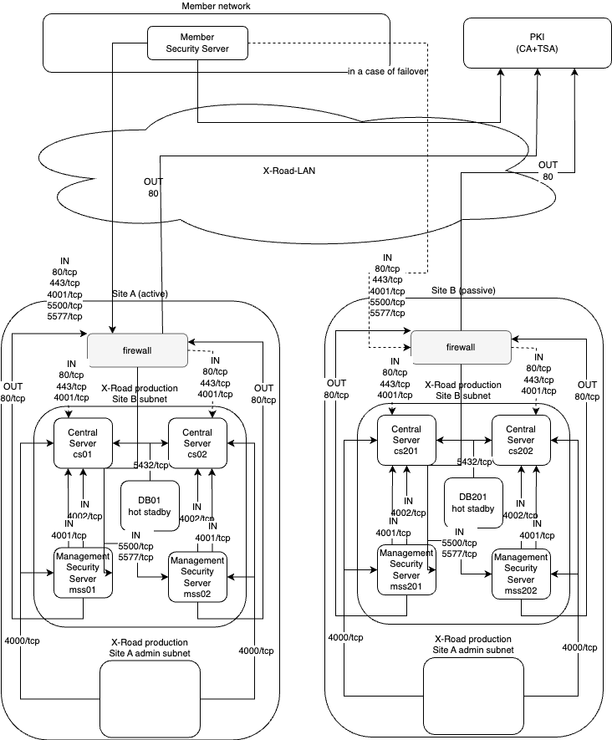
Turkmenistan X-Road Center HA
Lets sketch this!

Slide 29
Central Server Maintenance
Logging
Updating

Slide 30
Configuration in UI/API.
UI is using the API itself as well, all the configuration that is available through UI is available through API
X-Road instance configuration
Global configuration
TSA settings
CA/OCSP settings
Management member settings
Members
Management requests
Security servers
General settings
API keys for remote management

Slide 31
Configurations in configuration files
Configuration files that can be changed:
/etc/xroad/db.properties - db connection settings
/etc/xroad/devices.ini - HSM configuration if HSM is used with Central Server
/etc/xroad/conf.d/local.ini - general configuration parameters for Central Server.
Description of parameters what can be changed in configuration files and elsewhere for Central Server:
https://github.com/nordic-institute/X-Road/blob/master/doc/Manuals/ug-syspar_x-road_v6_system_parameters.md#4-central-server-system-parameters

Slide 32
Configuration in Database
Configurations in database require connecting directly to the database through command line to execute commands.
Information what can be changed in the database is in the documentation: https://github.com/nordic-institute/X-Road/blob/master/doc/Manuals/ug-syspar_x-road_v6_system_parameters.md#42-system-parameters-in-the-database
How to change parameters in the database is described also in documentation: https://github.com/nordic-institute/X-Road/blob/master/doc/Manuals/ug-syspar_x-road_v6_system_parameters.md#22-changing-the-system-parameter-values-in-the-central-server-database

Slide 33

Network changes, moving of central servers…
Moving CS or changing its network address is tricky.

Slide 34
Logging
All logs are stored inside the virtual machine by default.
/var/log/xroad folder
Logfiles:
Audit.log - log all actions that are done in the Central Server
Configuration_client.log - logs everything regarding Global configuration generation
Centralserver services log - all logs regarding the services that the Central Server provides.
Signer.log - everything regarding signing configurations files.

Slide 35
Central Server restore/backup

Slide 36
Brake
Continue at 11:10

Slide 37
Member Management
Practice of
Adding security server
Adding member
Adding sub-system

Slide 38
Adding member
Member is the primary object that everything is tied to, so that is the first step.
Central server > Members > add Member
Three values are required:
Member name - Usually the name of the organisation that is joining
Member class - Type of member organisation, COM, GOV, EXT
Member code - Some form of official identification of the organisation, like Tax code for example
Members can be added before joining or during joining, depends on the joining process that is used.

Slide 39
Adding Security Server
Adding Security Servers is most commonly done through Management Requests but it is possible to add them manually as well.
Central Server > Management Requests > select an open request.
By default, Central Server only shows active requests, requests done or rejected are hidden
Requests can be either accepted or rejected.
If Request is accepted, Central Server will automatically add all the required information under the member to register the Security Server
If Request is rejected, nothing will be added.

Slide 40
Add Subsystem
Adding a subsystem is done similarly like Security Server, through Management Requests or manually.
Central Server > Management Requests > select an open request.
By default, Central Server only shows active requests, requests done or rejected are hidden
Requests can be either accepted or rejected.
If Request is accepted, Central Server will automatically add all the required information under the members Security Server to register the Subsystem
If Request is rejected, nothing will be added.

Slide 41
Member Management
Why it is not just a record in the database

Slide 42
Member
Each member must take care of their own security!
Operator validates the identity for automated processing.
What defines a member? / How to validate a member?
What to require upon joining?
Declaration or proof?
Why are joining requirements relevant?
Who, Why, When and Why not?

Slide 43
Brake
Continue at 13:10

Slide 44
Operation
Maintenance
Debugging
Typical issues
Monitoring
SLA

Slide 45

Operator Team
Team Lead
Evangelist
Architect / Trainer of APIs
Service owner (X-Road)
Monitoring expert
Member manager
Service owner (PKI)
CA operator
Infrastructure operator / Sys admin
(Support)

Slide 46
Monitoring
Java Application / Not X-Road Specific Monitoring
Security Server is yet another java application
X-Road processes must be running
Application must have enough resources
Finding issues before they become problems is important for a stable ecosystem.
Component Governance / Environmental Monitoring
What protocol versions and feature set is used by members?
Are members maintaining technical components?
API Governance / Operational Monitoring
Who are biggest stakeholders?
How members depend on each-other? Relationships and dependency?
How to stick API responsibility to owners?
Notes:
Riho: Finding issues before they become problems is important for an stable ecosystem.

Slide 47

Service Level Agreement
Global configuration - window of expiry defines time criticality. High integrity risk!
Member management
Management services - member management processes
Certificate Issuance - must fit into member management SLA
OCSP (if internal) - balance security with availability
Timestamping (if internal) - balance security with availability
Core components repository or mirror - some availability, reasonable integrity.
Support - for fall your clients
Reaction service on security incidents - consider abuse.

Slide 48
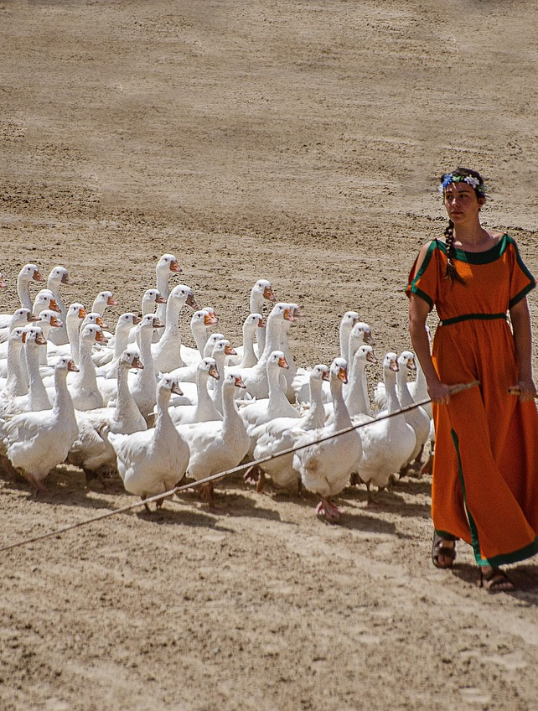
Follow the Vendor
niis.org / xroad.global Nordic Institute for Interoperable Solutions
Release notes and roadmap
NIIS documentation as source of truth
Customize for local usage
Mirror for software

Slide 49

Daily Routine
Helping members with their questions
Check for management requests
Monitoring X-Road servers/services
Prepare and test update for X-Road

Slide 50

Helping new and existing members
Routine questions about X-Road, service etc.
Help debugging Members problems with their Security Servers or services.

Slide 51

Management requests
Check for new management requests and fulfill them.

Slide 52

Updates and testing
Preparing and testing new releases of X-Road components.
Not in client facing environments (TM, TM-TEST, TM-DEV)

Slide 53

Debugging
Global config
Management services
Notes:
Kas see on practice?

Slide 54
Security
How X-Road ensures security of the platform and services of its members
Availability
Confidentiality
Integrity

Slide 55
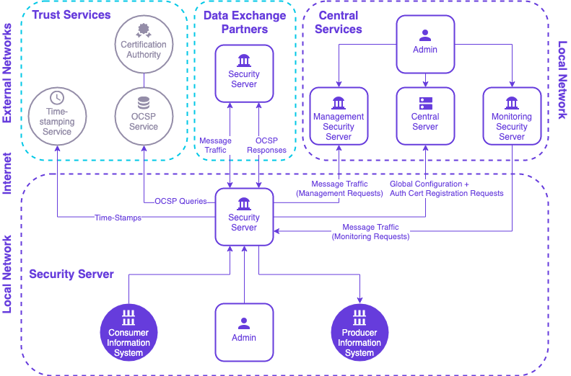
Security Design
Scalability
Neutrality from below
underlying IP-network is usable, not secure
Neutrality from above
Any member can use for any business scenario
Availability
Controlled by the service/API provider
CS/MSS/OCSP/TSA availability does not affect API availability.
Confidentiality
Temporary two-ways encrypted channels
Integrity/non-repudiation
Digitally signed data/messages
Resource effectiveness

Slide 56
Consumer
Provider
Consumer IS
Consumer SS
TLS connection
Provider SS
Provider IS
Req
SecEnv
SecEnv
Req
Req
Req
SecEnv
SecEnv
Resp
Resp
Resp
Resp

Slide 57

Availability Implications
Parameter | TM | TM-TEST | TM-DEV
confExpireIntervalSeconds | 172800 (48 hours) | 345600 (96 hours) | 345600 (96 hours)
ocspFreshnessSeconds | 129600 (36 hours) | 259200 (72 hours) | 259200 (72 hours)
timeStampingIntervalSeconds | 86400 (24 hours) | 86400 (24 hours) | 86400 (24 hours)
Notes:
Comment
Must be more than worst case central server downtime.
Must be longer than maximum planned OCSP downtime.
Must be shorter than ocspFreshnessSeconds but longer than maximum planned timestamping downtime

Slide 58
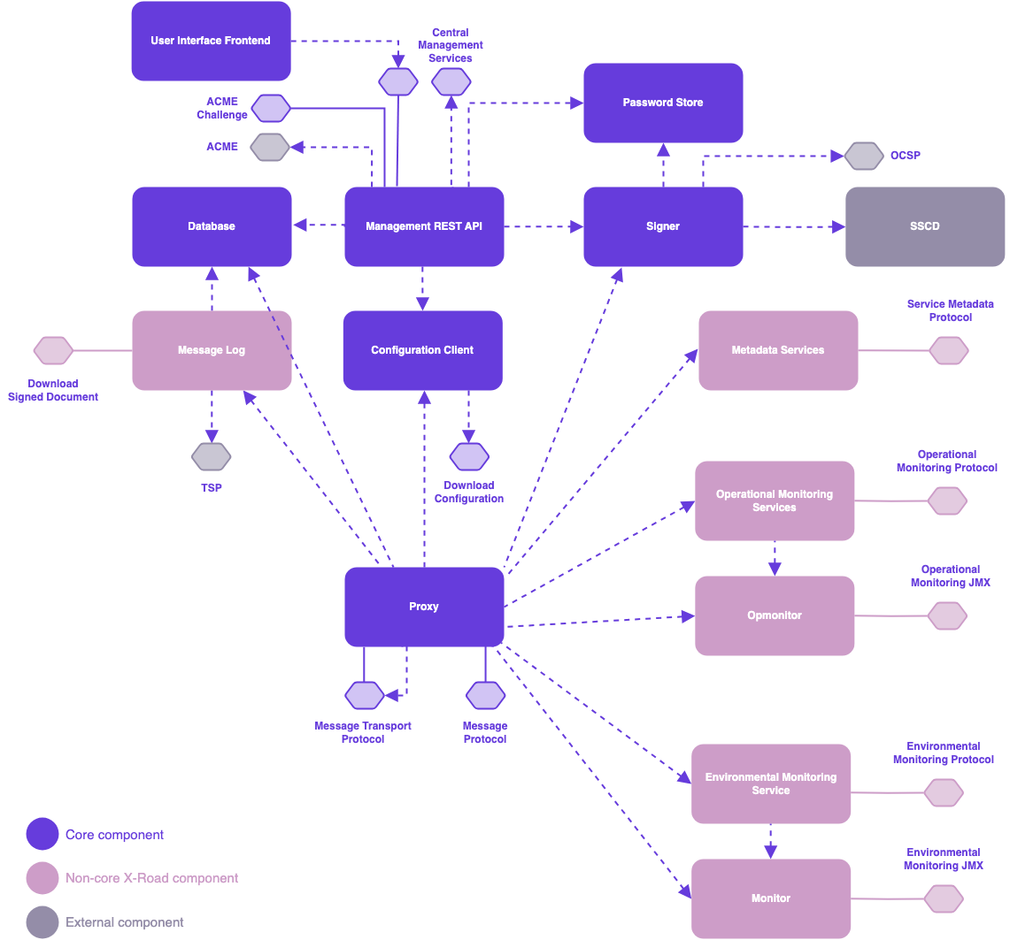
Message Log
Timestamping configuration: immediate … bulk
It is a database… keep it light!
Extraction and verification of the evidence:
Only from database
Only if you know the message id!

Slide 59
Governance
Good ownership of the platform is more then setting up security servers…

Slide 60
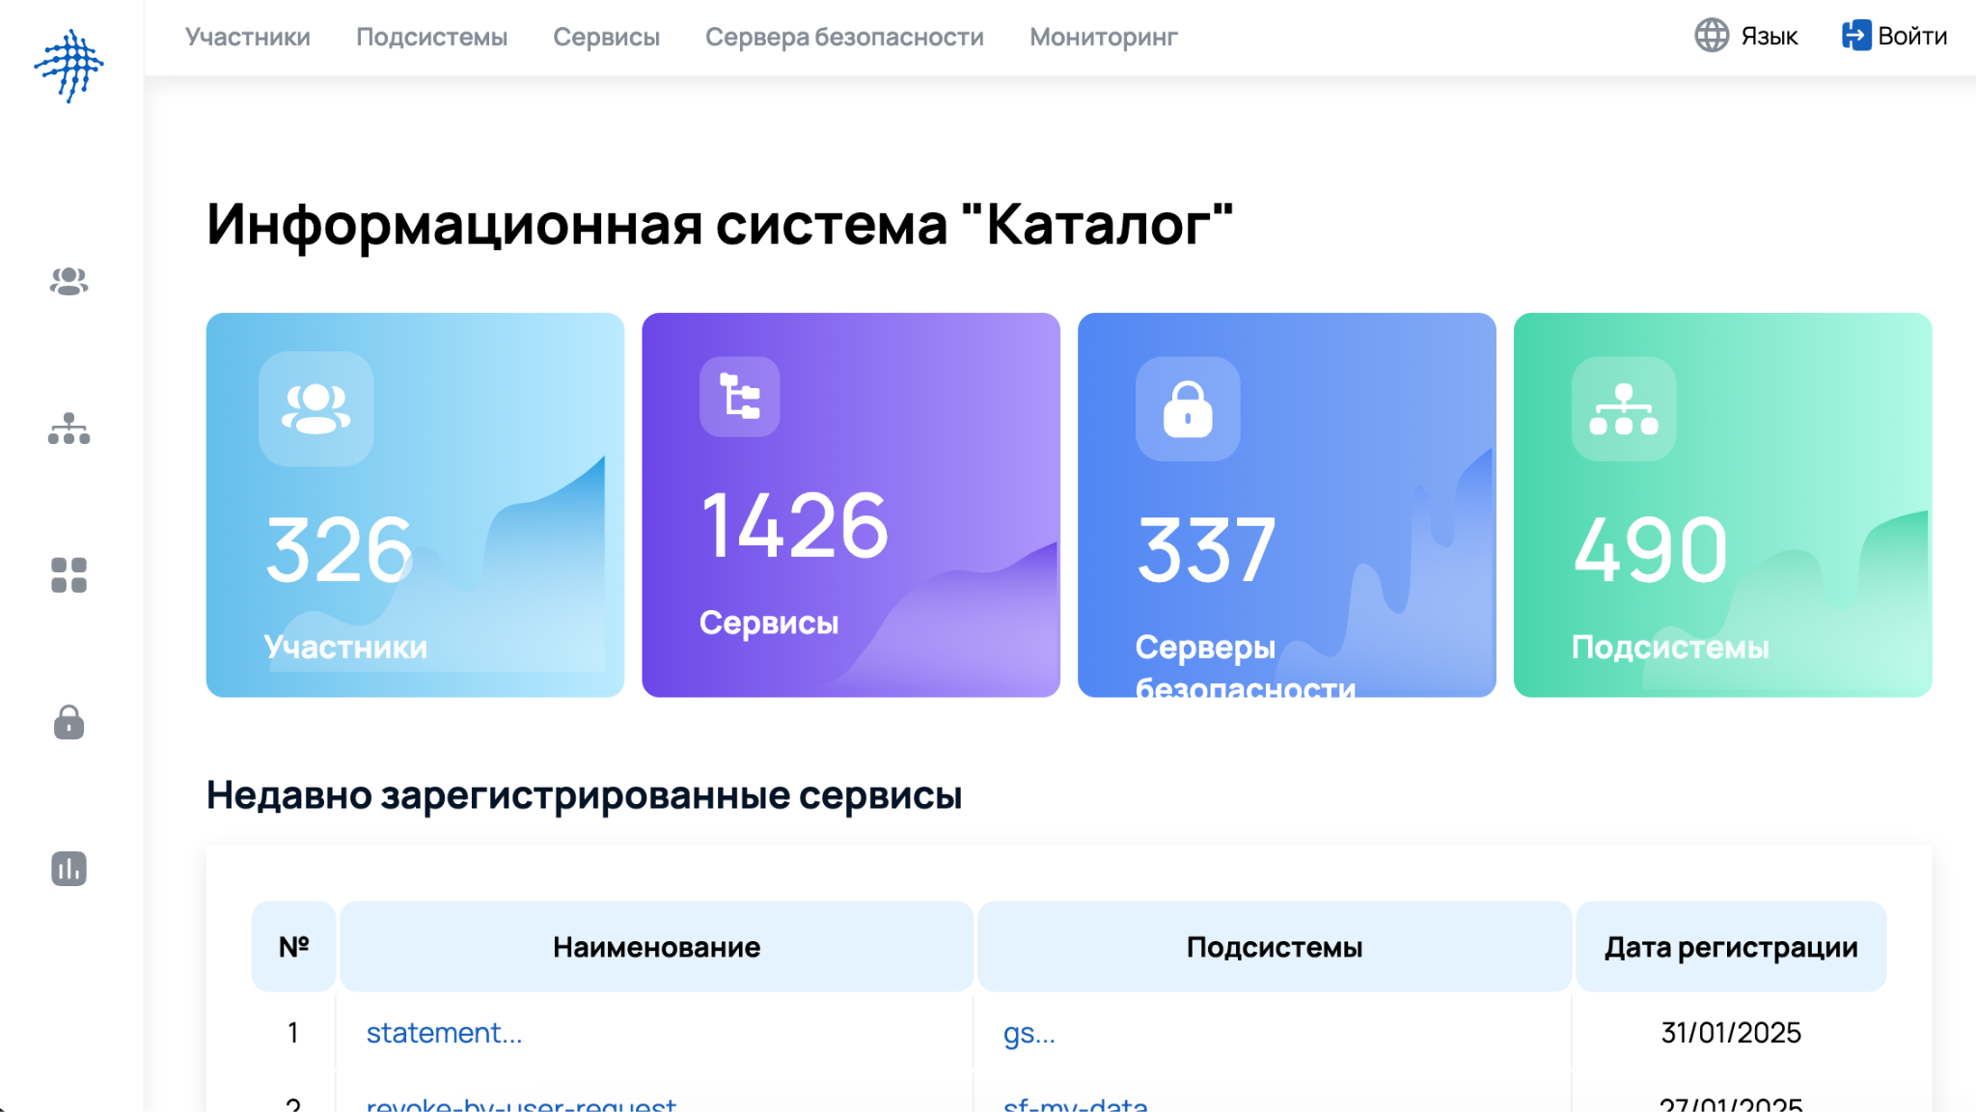
Tools Supporting Operation
Landing page / self-service
Monitoring (by needs)
Public Catalogue of Members and Services
Trainings / API examples and tutorials

Slide 61
Governance Tasks
Developer
Easy API creation
dev
IS provider
Business integrity testing
test
Trust services management
One or several
Internal or external
Timely cryptography
Instance Cleanup
Legacy security servers
Old protocols
Release management
Two mirrors recommended
IS owner / ISP
Integrity between businesses / trust services integrity
(pre)
IS owner
Business operation
prod

Slide 62
Interoperability Governance & Change Management
Manage the security policies
Can member tamper with security server configuration?
Manage changes
Components (security server releases)
Protocol changes
Member requirements and policy changes

Slide 63

Capacity Building
Member component setup
Essential system operation and management
Security aware system administration
SecDevOps
Service development and API integration
API development stacks
API design and architecture
SOA and Microservices approach
Service design and integrated public services
Redesigning business services
Cooperation between MDAs
Training and skill building (and LMS) available.

Slide 64
Operator Roadmap
Member management process
Tools and channels to exchange configuration anchor and CSRs and certificates
Technical order of steps for operators
For users, steps to join / guide
Terms of use (initial)
SLA for all client facing instances
Engage members
At all levels (higher executives, process owners, engineers/architects/developers)
Facilitate member-to-member integration negotiations
Continue
Build capacity (trainings and support) for clients
Identify local barriers for using X-Road
What are the highest priority things that must be done to ensure good start of the operation of the p platform?
If it helps to bring in new members, then it is the right thing!

Slide 65
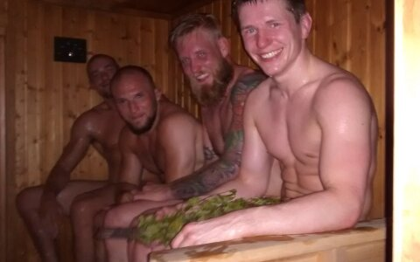
Community
X-Road Core
Business IS
Community tools
Ecosystem
There is great potential between stakeholders - your members, clients and users.
Between themselves.
Arrange for the opportunities to meet.

Slide 66

How X-Road Has Failed?
Not naminng names but …

Slide 67
Questions?

Slide 68
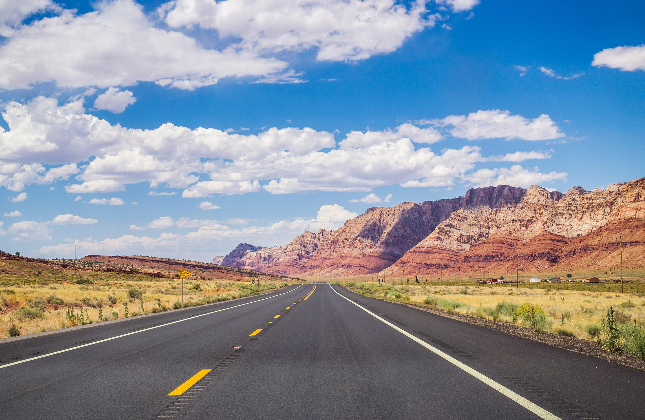
Test
20 questions
70% to pass
lms.xroad.gov.tm

Slide 69
Thank you!

