Slide 1
Trust Service Infrastructure
Trainer: Kristjan Kullerkann

Slide 2
Agenda
Topic | Estimated time
Intro and opening | 14.30
Recap of theory | 14.45
CA practice | 15.15
Break | 16.20
CA practice continues | 16.40
Timestamping practice | 17.15
Q&A | 18.00
Test | 18.15
Notes:
Estonian time: 11.30 - 15.30.

Slide 3
Disclaimer
The training scope is related to the scope of the project (structured into several pieces of training).
This is training for trainees - what you need to learn, we do our best to deliver.
Based on trainee activity, the duration of the training is reasonably flexible in both directions.
During the project the training is covered by a warranty for trainees - you can bring up a topic touched in the training during warranty to ask for clarifications.
Training is the best source for new knowledge - this is also tested at the end.
To become an expert, you will need to put all you have learnt into constant practice.
House rules:
Online training: camera-on and microphone-off discipline.
Rise attention if you have a question.

Slide 4
Introductions
Trainers
Aragatnashyk team
{name of trainer}
{experience of trainer}
Who you are?
Current position?
Experience with PKI?
Expectations for the training?

Slide 5

Asymmetric Cryptography

Slide 6
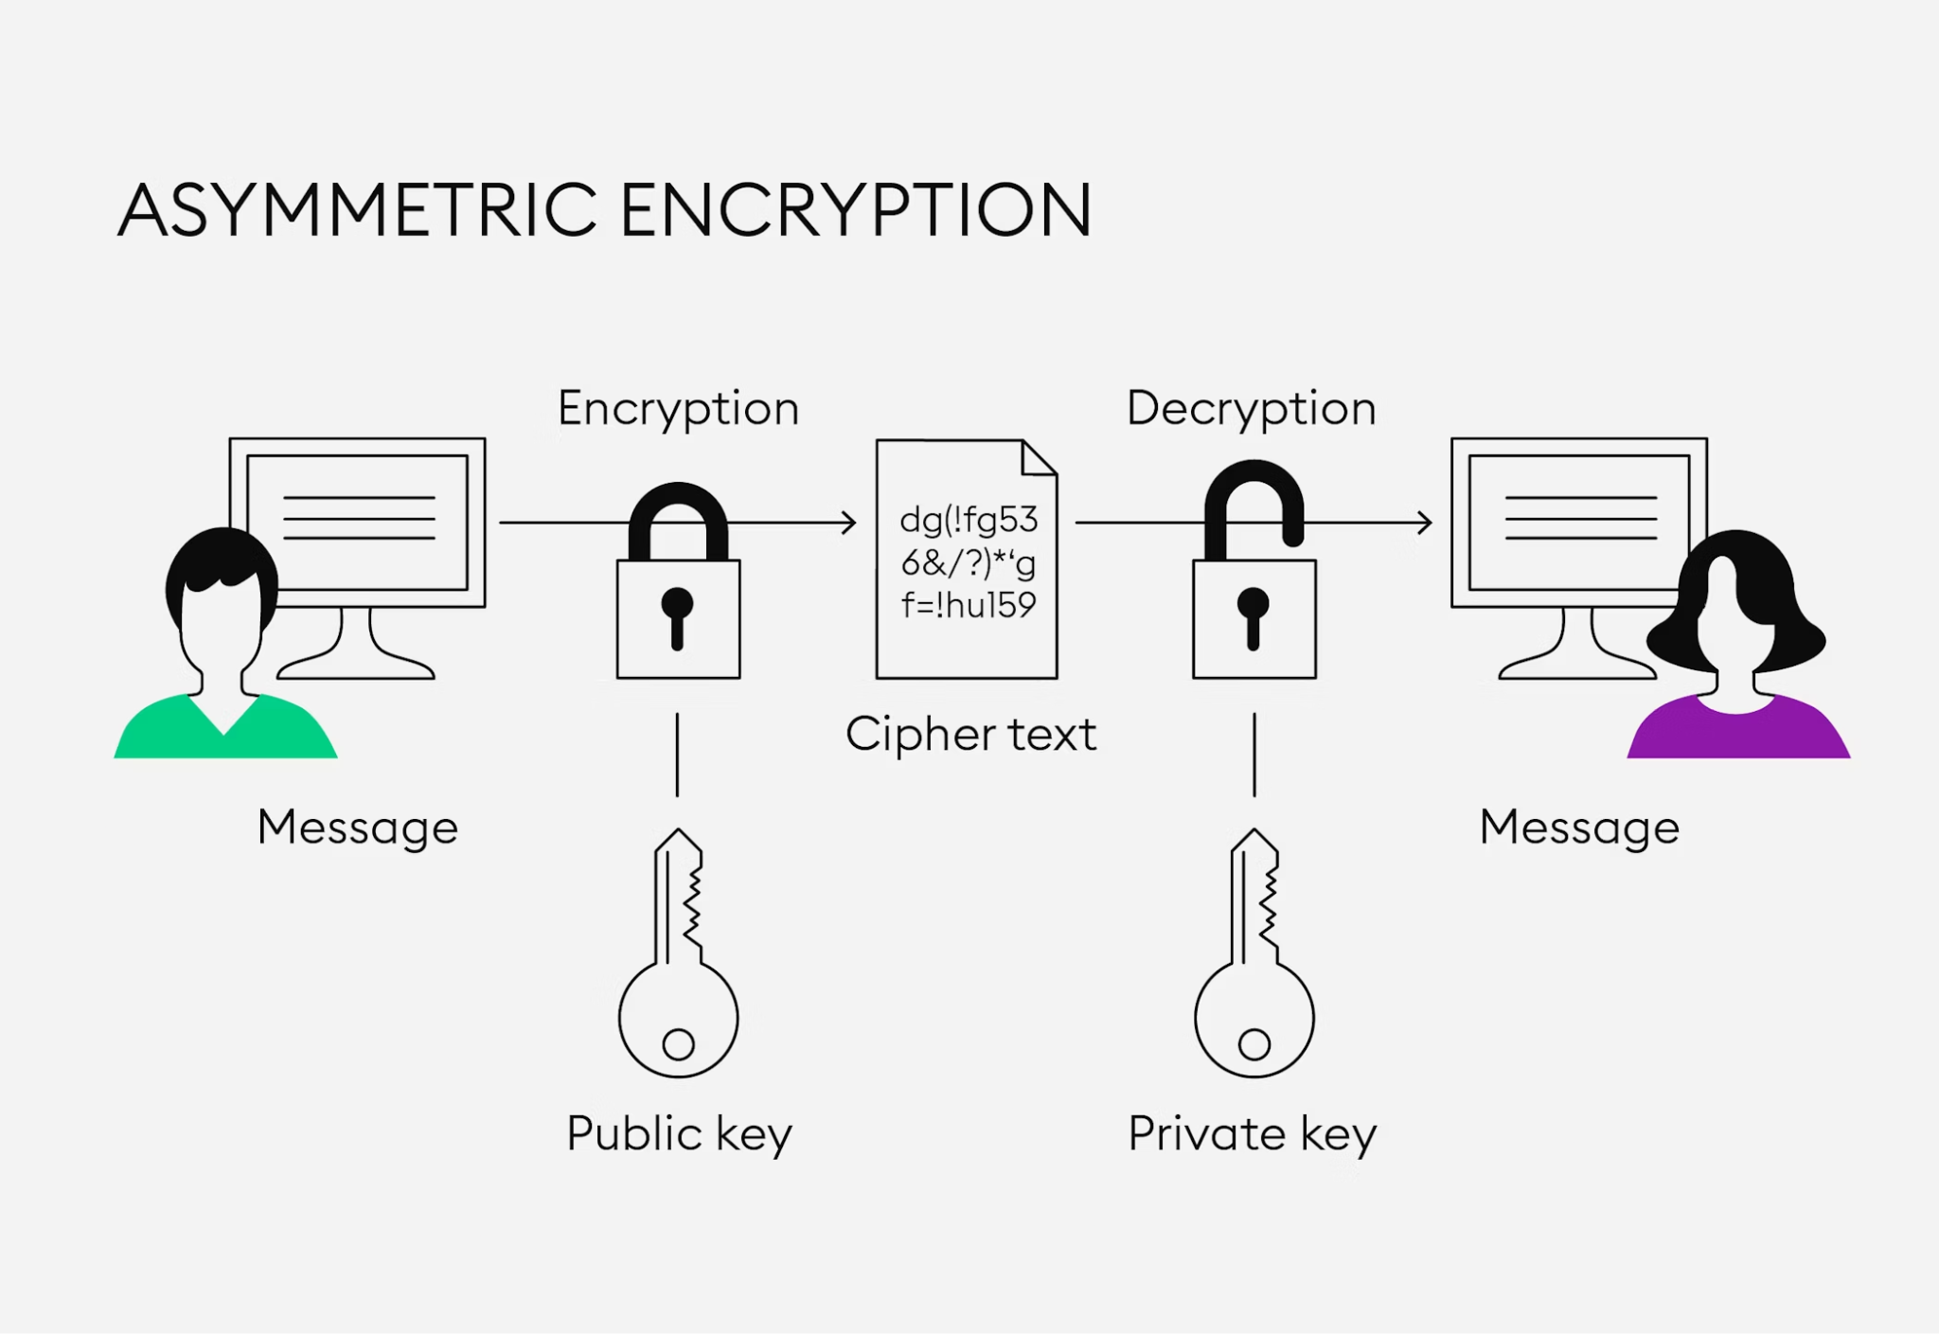
Asymmetric Key Generation
Always a pair of keys for a subject
Image from https://bitpanda-academy.imgix.net/450037a5-144d-44ef-9db1-7fe7ce1f433d/bitpanda-academy-expert-20-what-is-asymmetric-encryption-infographic.png?auto=compress%2Cformat&fit=min&fm=jpg&q=80&w=2100

Slide 7


Certificates
Alice
Bob
Certificates link keys to subjects
Registration Authority (RA) ensures the authenticity of the subject.
Certificate Authority (CA) Creates a certificate – digitally signed confirmation of a public key being binded to the identity of the subject.
Validation Authority (VA) Ensures that information about the certificate is valid and available.
Read: The owner is in control of the private key.
A private
B private
RA/CA/VA (public)
A public
B public

Slide 8
Encryption – only Bob can read original message
Alice
Bob
Message to Bob
Message to Bob
B public
decrypt
encrypt
0x989AE29
0x989AE29
B private

Slide 9
Signing – Bob can be sure that it was from Alice
Alice
Bob
Message to Bob = x from Alice
Message to Bob = x
Container
Message (x)
Signature (S)
[A public key]
OCSP(A, time)
RA/CA/VA information
A private
Verify if S = decrypt(hash(x), A public)
S = encrypt(hash(x), A private)
S = 0x989AE29
S = 0x989AE29
A public

Slide 10
Timestamping – Alice creates evidence about existence of some data in specific time
TSA
Alice
h = hash(data)
h
T private
Container
Hash (h)
Timestamp (TS)
[T public key]
OCSP(T, time)
RA/CA/VA information
Verify if TS = decrypt(hash(data), T public)
TS = encrypt(h & time, T private)
TS = 0x989AE29
TS = 0x989AE29
T public

Slide 11


Asymmetric Cryptography Works Only If…
The private key is kept secret - high confidentiality.
HSM, SSCD, QSCD, etc.
PIN is not your private key.
Public key is available – high integrity and availability.
RA/CA/VA audits and insurance.
Mathematics is correctly implemented.
ROCA-vulnerability in 2017!
https://arstechnica.com/information-technology/2017/10/crippling-crypto-weakness-opens-millions-of-smartcards-to-cloning/
Notes:
SSCD - Secure Signature Creation Device
QSCD - Qualified Signature Creation Device
ROCA - cryptographic weakness that allows the private key of a key pair to be recovered from the public key in keys generated by devices with the vulnerability.

Slide 12

Public Key Infrastructure
Technology and organisation that executes the asymmetric cryptography

Slide 13
PKI Overview
EJBCA
Protects cryptographic keys
Certificate
Authority
Security Server operator
Requests certificate
Requests certificate
Registration
Authority
Generates certificate signing request
Installs certificate
Hardware Security Module
Queries certificate status
Validation
Authority
Requests certificate status
Security Server
SignServer
Requests timestamp
Timestamping
Authority
Protects cryptographic keys

Slide 14

Certificate authority
Two-tier architecture
Root
Intermediate
Issues certificates
Signs certificates
This signature assures that the certificate is authentic and trusted by anyone who recognises the CA as legitimate
Provides certificate revocation list (CRL) and certificate statuses (OCSP database)

Slide 15

Validation authority
Online certificate status protocol (OCSP)
Is the certificate valid
Used by X-Road
Has obsoleted CRL
Certificate status is queried from the CA database
Can be configured as a separate application instance

Slide 16

Registration authority
Verifies user identity
Approves certificate requests
Manages certificate lifecycle
Request certificate from CA
Can be configured as a separate application instance

Slide 17

Timestamping authority
Provides digital timestamp for security server message log
Timestamping certificate issued from dedicated intermediate CA
Cryptographic keys are protected by HSM

Slide 18

Certificate issuance process
Certificate signing requests (CSR) are generated on the security server by the system administrator
The system administrator sends CSR to the registration authority (RA)
RA validates CSRs
RA forwards CSRs to certificate authority (CA)
CA signs CSRs (issued certificate)
CA operator sends certificate to security server operator

Slide 19
Certificate revocation process
The certificate revocation process is started for various reasons
The Security Server ceases operations
The Security Server’s private key is compromised
Security Server is not in use anymore
The CA operator is notified about the need to revoke a certificate
CA operator revokes certificate in CA database
VA starts to respond with revoked status (with reason included) on certificate status request
CA generates a new CRL

Slide 20

Hardware Security Module (HSM)
Purpose-built device to protect cryptographic keys
Keys are loaded from the client to HSM when activating
Keys at rest are on client as binary objects (/opt/nfast/kmdata)
Tamper-resistant certified device
Alerts on tampering
Only the manufacturer is allowed to open the device!
Otherwise, trust is lost.
Provides trust

Slide 21
Hardware Security Module (HSM) - card sets
K/N policy
Keys (smart cards) for various activities
The administrator card set (ACS) is for device administration
Initialization
Restore
Can not be reused!
The operator card set (OCS) protects cryptographic keys
Do not leave in HSM!
Used when activating (starting and restarting) CA and TSA
Physical presence is necessary
Can be formatted and reused
Cards must be stored in a secure location!

Slide 22

HSM - preparation for installation
Remote file system (RFS)
Stores HSM configuration
Card sets
K/N considerations
Policies
Who is allowed to administer the device
All activities should be logged

Slide 23
HSM - initial configuration
RFS must be ready
With the first device a new security world is created
Subsequent devices load existing security world
Clients (IP addresses) must be added
It can be added later as well

Slide 24

HSM - backup
Backup /opt/nfast on RFS
Backup /opt/nfast on all clients
Copies of card sets can be created for backup
Must be stored in a secure location!

Slide 25
HSM - restore
Install client software on RFS
Restore /opt/nfast/kmdata of RFS
Configure HSM and load existing security world
ACS are needed for authorisation
Install client software on clients
Restore /opt/nfast/kmdata on clients

Slide 26

HSM - maintenance
Firmware upgrades
Provided by manufacturer
Security world software upgrades
Provided by manufacturer
Clients must be upgraded as well

Slide 27
HSM - key processes
Restoring HSM needs ACS
OCS is needed for CA and SingServer startup

Slide 28
HSM - recommendation and considerations
Build monitoring scripts around nfkminfo output
Procure at least 1 device to test the environment
Procure additional devices for production for HA
Procure remote operator feature to be able to manage everything remotely
Including operations with ACS/OCS
Collect logs with log collector and store them on log server

Slide 29
Registration authority (RA) using EJBCA
Part of EJBCA
RA web for issuance
Revocation is done in the EJBCA admin web

Slide 30

Certificate issuance demo

Slide 31
Certificate revocation demo

Slide 32

Timestamping authority (TSA) using SignServer

Slide 33

TSA - preparation for installation
Needs PostgreSQL database for persistence
Proxy for TLS termination

Slide 34
TSA - Initial configuration
Deployed with Ansible playbook
Docker container
Written in Java and runs on wildfly
Helm chart for Kubernetes available
Management CA (from EJBCA) for authentication
Could also have its own dedicated CA from EJBCA

Slide 35

TSA - backup and restore
Backup
PostgreSQL database
PostgreSQL should be put into backup mode when creating snapshot-based backups
Containers are stateless, so there is no need to backup
Restore
Restore database
Deploy containers with Ansible playbook
Site failover should be considered as an alternative to restore
Repmgr is used for replication management

Slide 36

TSA - maintenance
TSA certificate replacement
Software upgrade
Change the version in the playbook
Apply playbook

Slide 37

TSA - recommendations and considerations
Monitor with tsget/openssl
See pki/tests directory in TKM repository
Deploy test environment in HA mode
Tests should be considered as production
Create a development environment for internal testing
Purchase HSMs for test environment
Collect logs with log collector and store them on log server

Slide 38
Root Key Ceremony

Slide 39
Computational Trust and PKI
Computational trust is the generation of trusted authorities or user trust through cryptography.
In centralized systems, security is typically based on the authenticated identity of external parties, using Public Key Infrastructure (PKI).
PKI - a structure of hardware, software, people, processes, and policies that employ digital signature technology to facilitate a verifiable association between the public component of an asymmetric public key pair with a specific subscriber that possesses the corresponding private key

Slide 40
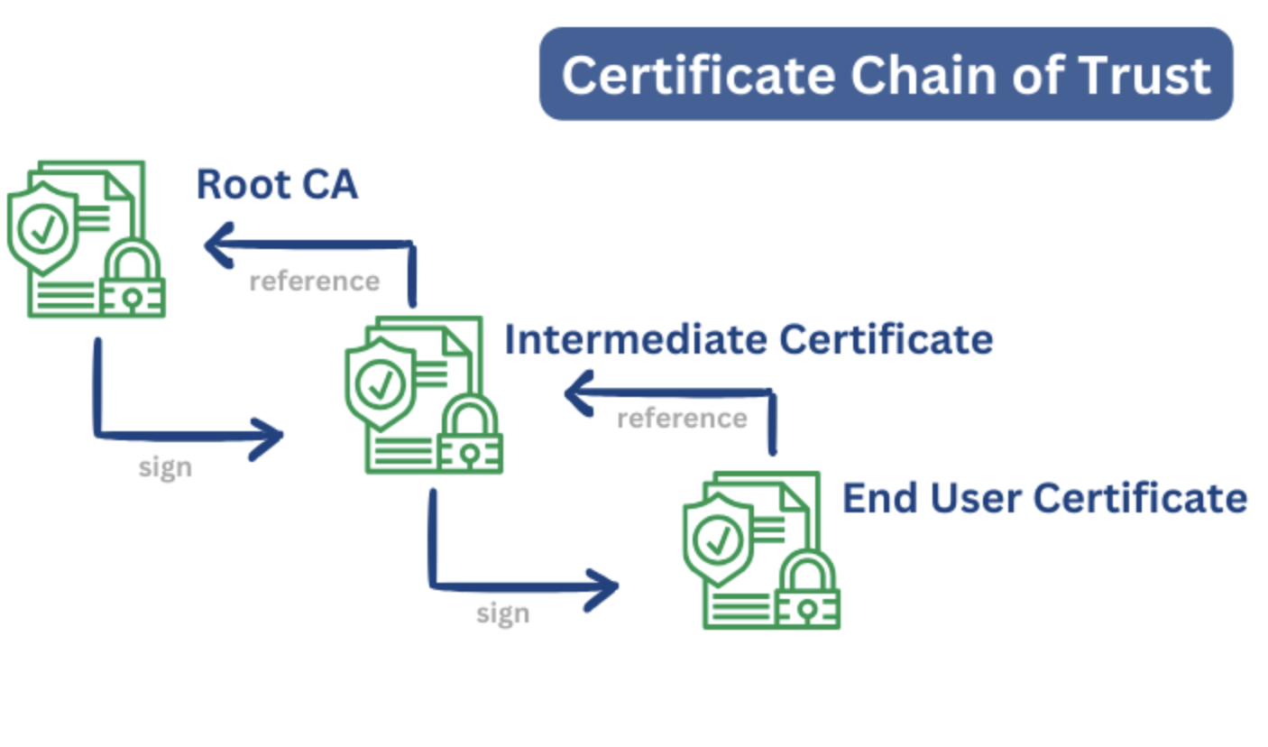
Chain of Trust aka Certificate Chaining
Certificate chaining - the verification of each certificate through another certificate, creating a chain of certificates that ends with the root certificate; a method to establish trust through a hierarchical structure of digital certificates.
Notes:
End user = end entity, could be a system/service

Slide 41
Root Certificate
Root of trust - component that needs to always behave in the expected manner because its misbehavior cannot be detected
Root certificate - self-signed certificate at the top of the PKI hierarchy
Notes:
End user = end entity, could be a system/service

Slide 42
Root Key Ceremony
Root Key Ceremony - a procedure where a unique pair of public and private root keys are generated and self-signed
The ceremony must ensure the trustworthiness of root keys through predefined step-by-step activities, personnel supervision, audit logs and a secure physical and technical environment.
This procedure takes place as a scripted meeting where individuals with specific roles carry out predefined tasks under the witness of all other participants.
Notes:
End user = end entity, could be a system/service

Slide 43
Root Key Ceremony Rules 1/2
1. The Ceremony Administrator (CEA) steers and guides the ceremony.
2. Participants follow the manuscript step-by-step, comparing the actions on the screen and the manuscript printout.
3. The CEA reads each step of the manuscript aloud, and then the Security Administrator (SA) performs the described activity.
4. At the beginning and the end of each step, the Primary Witness (PW) writes down the exact time on his/her copy of the printed manuscript.
Notes:
End user = end entity, could be a system/service

Slide 44
Root Key Ceremony Rules 2/2
5. During the ceremony, any participant may highlight possible issues or inaccuracies. In that case, participants agree on a resolution before proceeding. PW writes down the resolution or the fix on his/her copy of the manuscript printout and signs it (hand-written signature).
6. In the case of incidents (unplanned events) that impede the continuation of the ceremony, CEA consults with participants and decides on the way forward. PW writes down the decision on his/her copy of the manuscript printout and signs it.
7. Improvement suggestions may be communicated during the ceremony or at any time afterward.
Notes:
End user = end entity, could be a system/service

Slide 45
Roles and Responsibilities 1/2
Role (number of persons) | Abbreviation | Responsibility
Ceremony Administrator (1) | CEA | An individual (internal staff member) who coordinates and guides the successful execution of the ceremony according to the ceremony manuscript
Security Administrator (1) | SA | An individual (internal staff member) who technically manages all activities on relevant systems (HSM, RFS, EJBCA server, etc.)
Principal Witness (1) | PW | An individual (internal staff member) who validates the dutiful following of the manuscript and documents the final manuscript on paper
Staff Witness (1) | SW | An individual who validates the dutiful following of the manuscript and takes evidence photos during the ceremony
Lawyer (1) | LAW | An external or internal lawyer who validates the dutiful following of the script
Additional Witness (n) | AW | Optional individual(s) (internal or external) who validates the dutiful following of the manuscript
Notes:
End user = end entity, could be a system/service

Slide 46
Roles and Responsibilities 2/2
Role (number of persons) | Abbreviation | Responsibility
Cryptographic Administrators (3) | CRA | Individuals who possess and manage Administrator Card Sets (ACS) smartcards and corresponding passwords. ACS cards are used to control access to Security World configuration on HSM, as well as HSM recovery and replacement operations.
Cryptographic Operators of CA (3) | CRO (CA) | Individuals who possess and manage Operator Card Sets (OCS) smartcards of the CA and corresponding passwords. OCS cards are used to control access to application keys. For example, cards are needed when HSM is restarted.
Cryptographic Operators of OCSP (3) | CRO (OCSP) | Individuals who possess and manage Operator Card Sets (OCS) smartcards of the OCSP and corresponding passwords. OCS cards are used to control access to application keys. For example, cards are needed when HSM is restarted.
Cryptographic Operators of TSS (3) | CRO (TSS) | Individuals who possess and manage Operator Card Sets (OCS) smartcards of the TSS and corresponding passwords. OCS cards are used to control access to application keys. For example, cards are needed when HSM is restarted.
Cryptographic Administrators (3) | CRA | Individuals who possess and manage Administrator Card Sets (ACS) smartcards and corresponding passwords. ACS cards are used to control access to Security World configuration on HSM, as well as HSM recovery and replacement operations.
Notes:
End user = end entity, could be a system/service

Slide 47
Segregation of Duties
One person may carry several roles IF this does not lower the overall security by bypassing the segregation of duties, for example:
SA may hold one card of ACS, OCS (CA), OCS (OCSP), and OCS (TSS), i.e., has the role of one CRA, CRO (CA), CRO (OCSP), and CRO (TSS) at the same time
One person may be a CRO (for CA), CRO (OCSP), and CRO (TSS) at the same time
CRO may have a witness role
A lawyer may be the Principal Witness
It is not allowed:
Security Administrator also has the role of CEA, Principal Witness or lawyer
For one CRA or CRO, hold more than one ACS or OCS card of the same type, meaning one person cannot jeopardize the 2/3 card quorum.
Notes:
End user = end entity, could be a system/service

Slide 48
Segregation of Duties
All roles must be covered by the TKM. Estonian specialists train and support.
Consider the balance between the segregation of people for security but also their availability
For example:
During the reconfiguring of an HSM, 2/3 of CRAs must be available physically with their ACS cards and passwords
During the restart of an HSM, 2/3 of CROs must be available physically with their OCS cards and passwords
Notes:
End user = end entity, could be a system/service

Slide 49
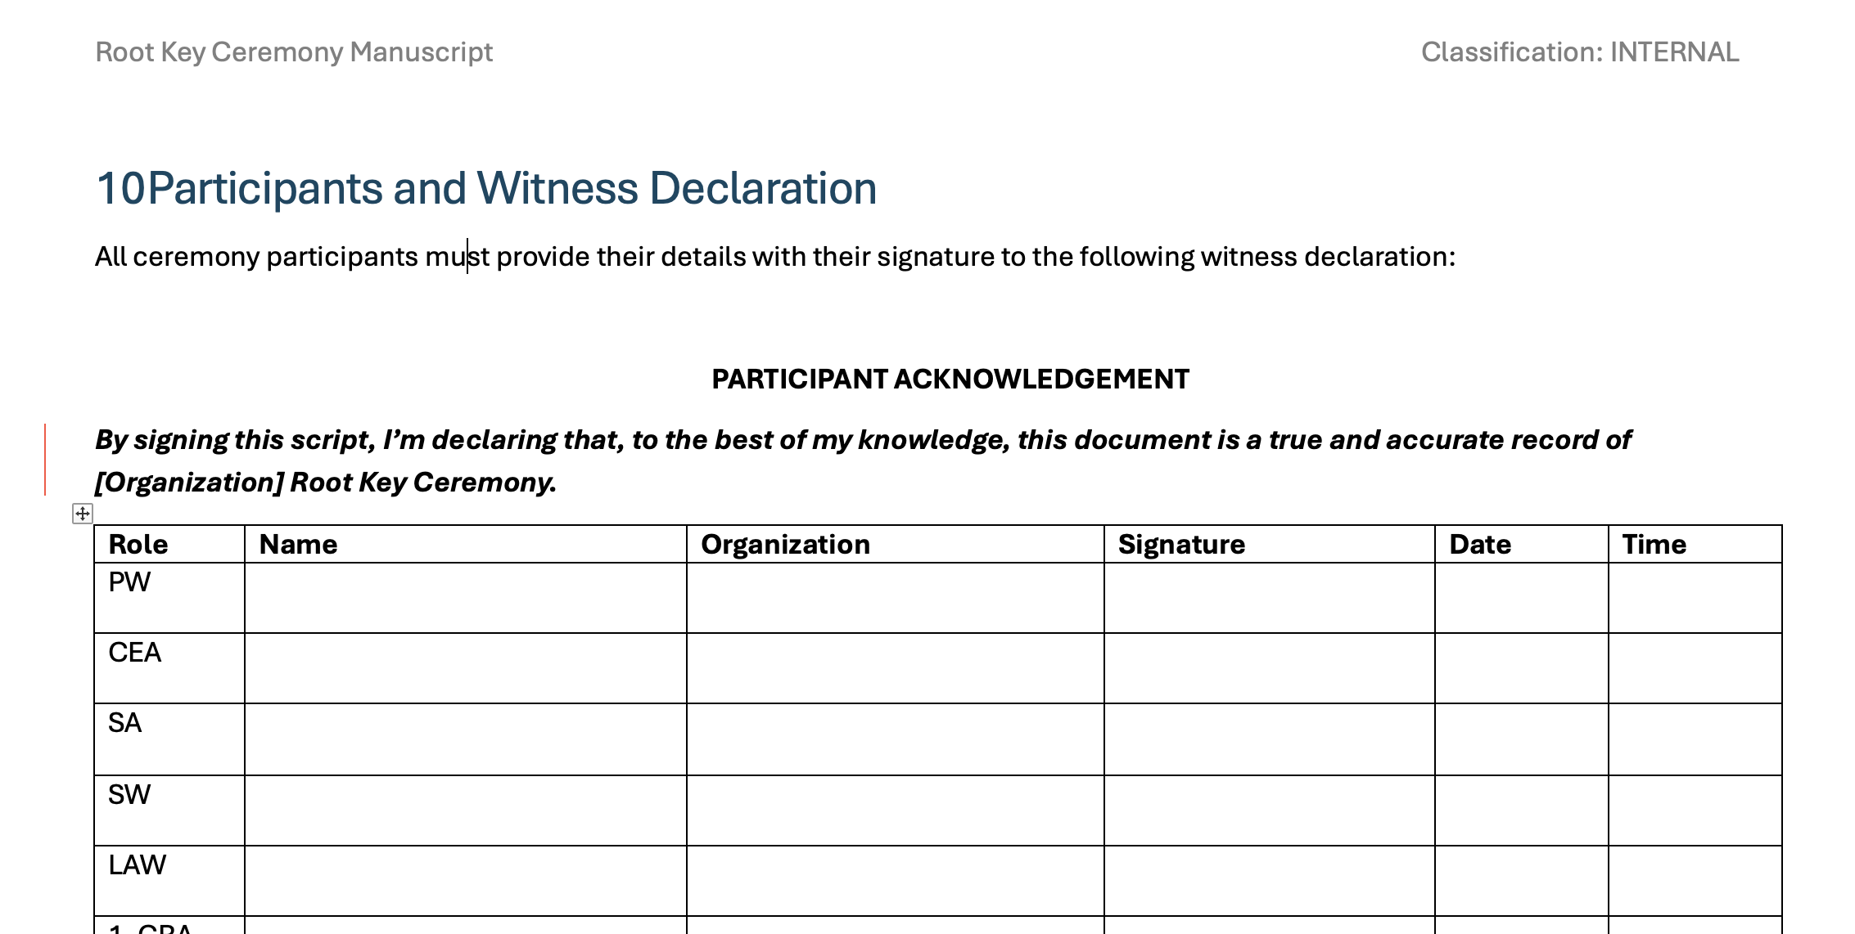
Participants and Witness Declaration
After the technical steps, all ceremony participants must provide their details and signature to the witness declaration sheet of the Primary Witness manuscript printout.
Notes:
End user = end entity, could be a system/service

Slide 50
Q&A

Slide 51
Training environment
Each trainee has their own VM
training.ca{1-5}.pki.gov.tm
Endpoints
training.ca{1-5}.pki.gov.tm - AIA, CRL, EJBCA admin web
training.ocsp{1-5}.pki.gov.tm - OCSP
training.tsa{1-5}.pki.gov.tm - Timestamping service, SignServer admin web
SSH credentials
Username: pki
Password: XroadPKI123!

Slide 52
Practice: Installation of EJBCA and SignServer
Needs PostgreSQL database for persistence
Proxy for TLS termination

Slide 53
Deploying EJBCA and TSA
SSH to training VM:
ssh pki@training.ca1.pki.gov.tm
Install ansible and git-lfs:
sudo apt install ansible git-lfs
Clone repository:
git clone https://gitlab.xroad.gov.tm/roksnet/tkm.git
Change directory:
cd tkm/pki/ansible
Install ansible roles:
ansible-galaxy install -r requirements.yml
Run ansible playbook:
ansible-playbook site_training.yml -i inventory/training.yml -e ansible_become_password='XroadPKI123!' --limit training.ca3.pki.gov.tm

Slide 54
Practice: Configuration and Testing of EJBCA
Needs PostgreSQL database for persistence
Proxy for TLS termination

Slide 55
Create Management CA
https://gitlab.xroad.gov.tm/roksnet/tkm/-/blob/main/pki/docs/management_ca.md#installation

Slide 56
Certificate end-entity profiles for Management CA
https://gitlab.xroad.gov.tm/roksnet/tkm/-/blob/main/pki/docs/management_ca.md#certificate-profile

Slide 57
Add end-entity and grant permissions
https://gitlab.xroad.gov.tm/roksnet/tkm/-/blob/main/pki/docs/management_ca.md#add-end-entity

Slide 58
Configure CRL Updater service for Management CA
https://gitlab.xroad.gov.tm/roksnet/tkm/-/blob/main/pki/docs/management_ca.md#crl-updater-service

Slide 59
Practice: Configuration and Testing SignServer
Needs PostgreSQL database for persistence
Proxy for TLS termination

Slide 60
Configure authentication and authorization
https://gitlab.xroad.gov.tm/roksnet/tkm/-/blob/main/pki/docs/timestamping_authority.md#administrative-access

Slide 61
Configure CryptoToken Worker
https://gitlab.xroad.gov.tm/roksnet/tkm/-/blob/main/pki/docs/timestamping_authority.md#software-backed-crypto-token-worker

Slide 62
Generate Keys
https://gitlab.xroad.gov.tm/roksnet/tkm/-/blob/main/pki/docs/timestamping_authority.md#generate-keys

Slide 63
Practice: Upgrading EJBCA and SignServer
Needs PostgreSQL database for persistence
Proxy for TLS termination

Slide 64
Upgrading EJBCA and SignServer
Read release notes!
Identify available container image version from https://hub.docker.com
Modify image version in both
group_vars/base/app_ca.yml
group_vars/base/app_tsa.yml
Run ansible playbook
ansible-playbook site_training.yml -i inventory/training.yml -e ansible_become_password='XroadPKI123!' --limit training1.ca.pki.gov.tm -t app_ca_post

Slide 65
Break
Let us continue at 16.40
When you have returned “switch on your camera” or “raise hand” to identify that you have returned.

Slide 66

Q&A

Slide 67
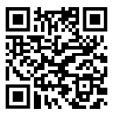
Test
You should have LMS registration e-mail in your inbox.
Log-in / change your password.
You have been enrolled to the “Trust Service Infrastructure” course.
Open the course and find “Trust Service Infrastructure Test”
https://lms.xroad.gov.tm/mod/quiz/view.php?id=3
Start the test. You will have up to 30 minutes to finish the test.
Assess what you have learned in the moodle environment.

Slide 68
Tomorrow let's see what does it take to operate the PKI stack.
Thank You!

