Slide 1
X-Road Introduction

Slide 2
Agenda
X-Road Architecture
X-Road Setup
X-Road Configuration

Slide 3
Data Exchange
Organisation A, B, ...
Organisation A, B, ...
Security Server
Secure Exchange of Data
Security Server
Information System
Information System
Operator
X-Road Central Components

Slide 4
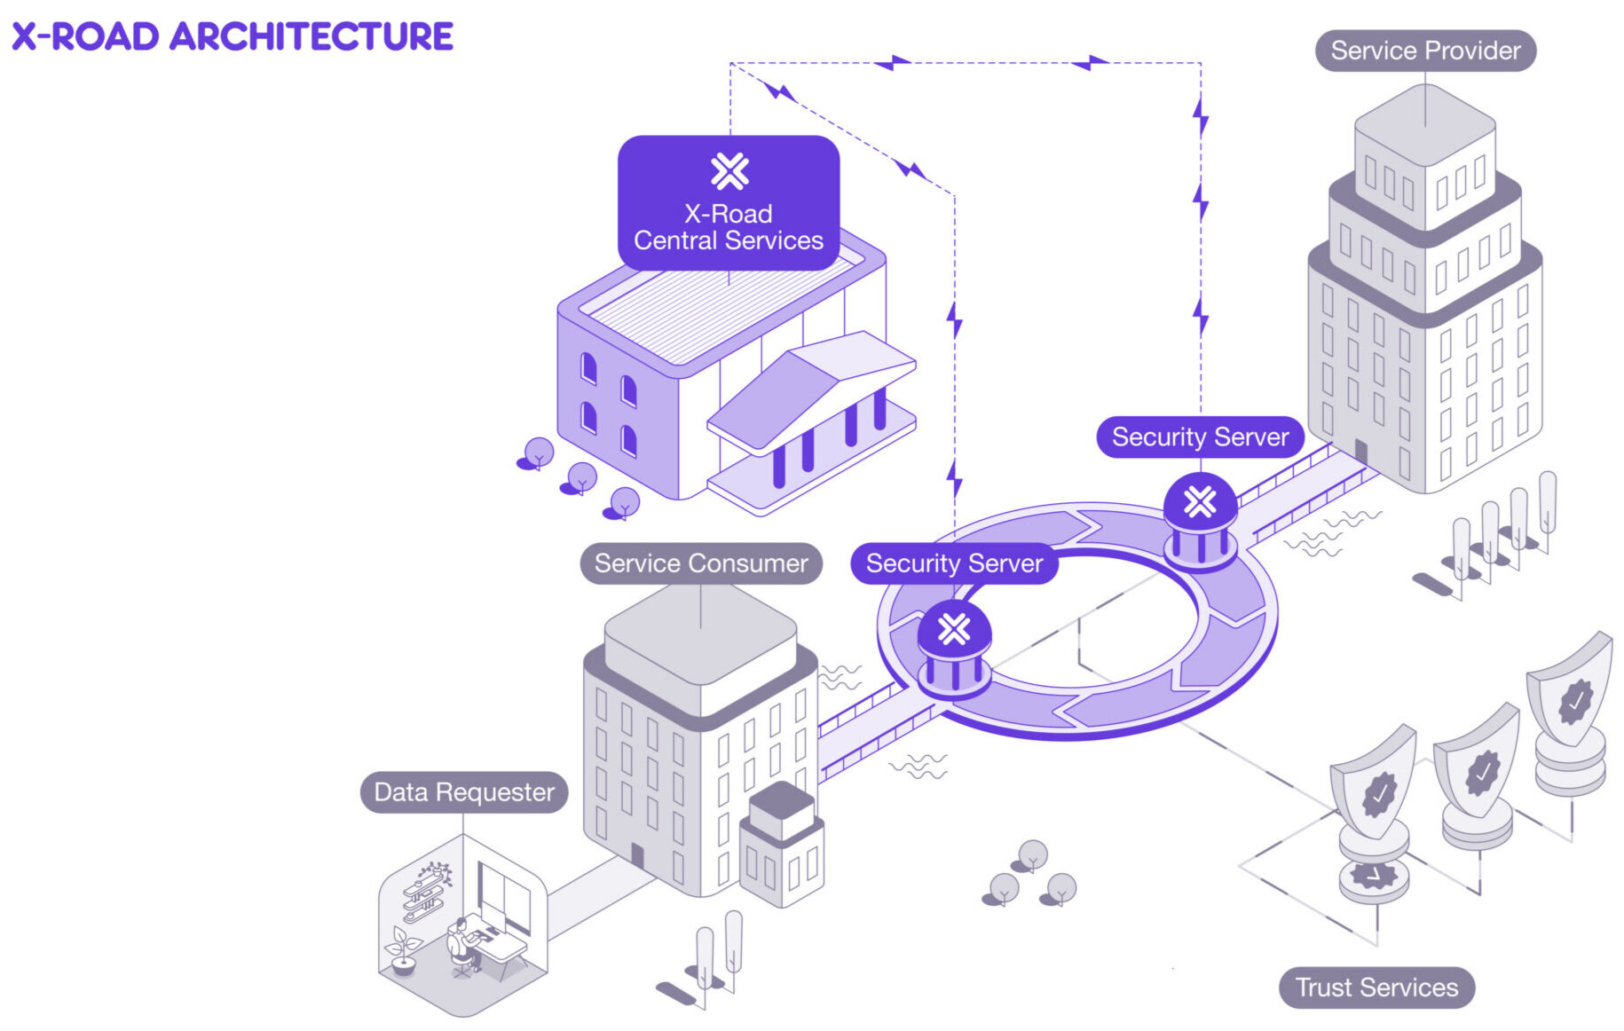
Main Components of X-Road ecosystem
Central Server
Security Server
Timestamping Authority
Certification Authority
X-road.global / niis.org

Slide 5
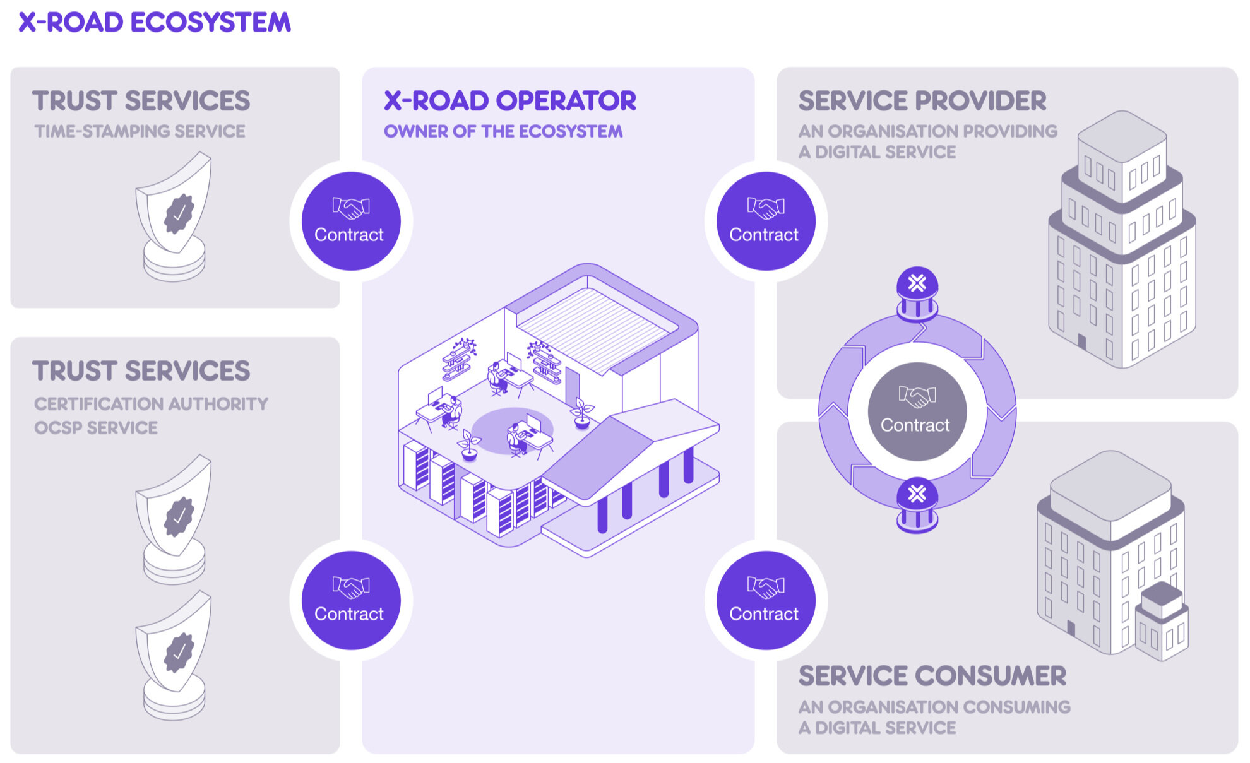
Function of the X-Road Center
Members
Security Servers list
PKI settings
Phonebook
X-road.global / niis.org

Slide 6
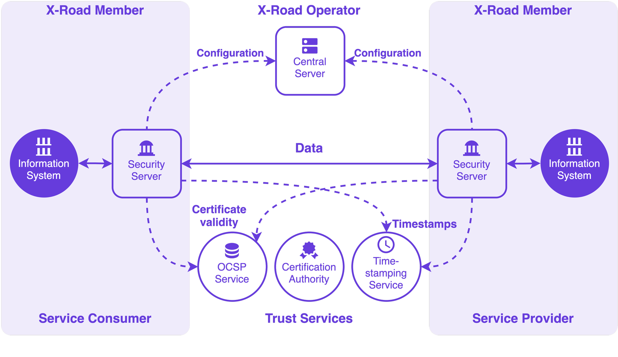
Function of Security Server
Secure connection between two members
Access Control for APIs
Logging

Slide 7
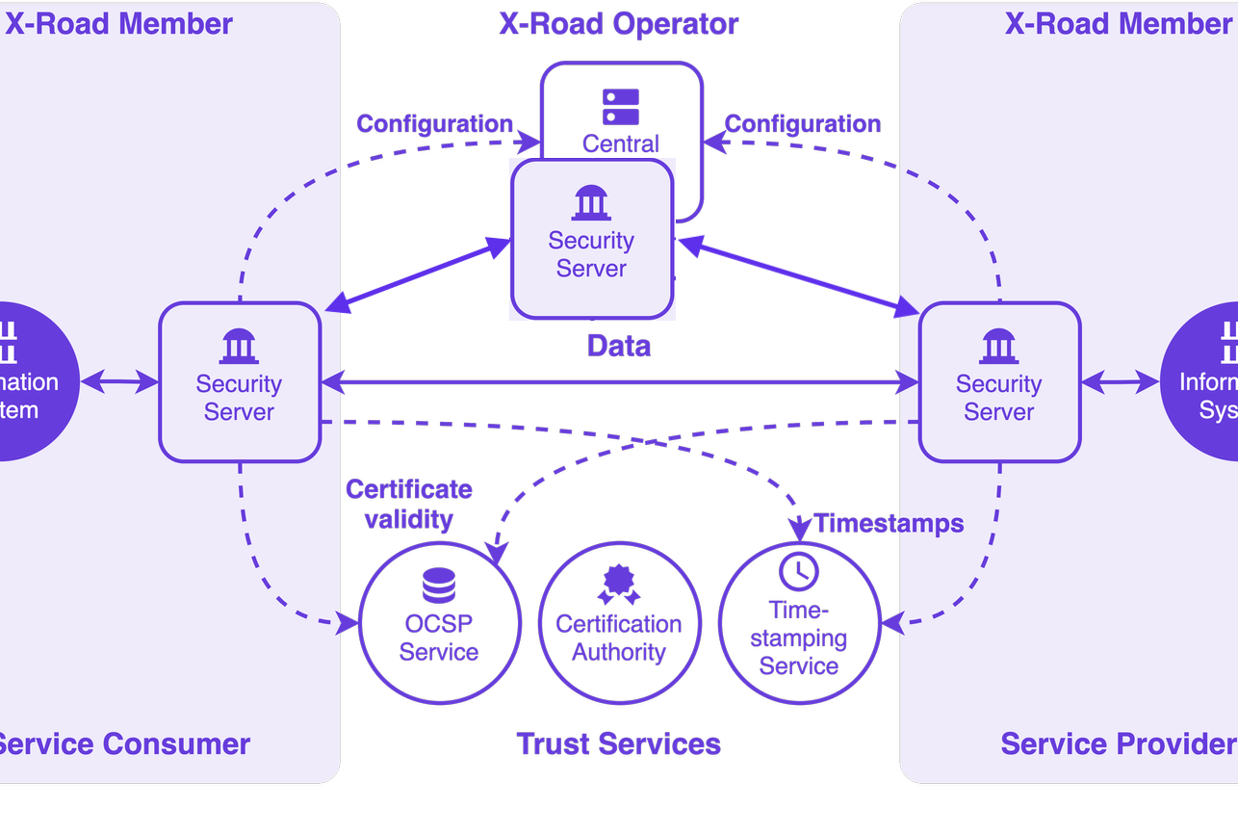
Management Security Server
Normal Security Server
Provides Central Server Member Management services to the instance Security Servers

Slide 8
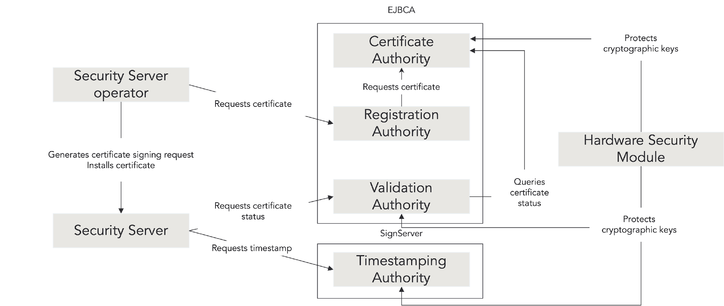
Why PKI is Needed
Security Servers require a minimum of two certificates to work.
Authentication certificate for the Security Server
Signature certificate for the Member
Timestamping of log files to provide evidence that nothing has been manipulated
3rd party to validate the members

Slide 9

Questions?

Slide 10

X-Road Setup

Slide 11

Order of Setup
Central Server
Management Security Server
Member Security Server

Slide 12

Central Server Configuration
Owner
Member types (GOV, COM, EXT)
PKI settings
Global configuration Signing
Management Services

Slide 13


Management Security Server
Owner institutions server
Generate Certificate Signing Requests(CSR)
Import signed certificates
Set up services under the subsystem

Slide 14

Member Security Servers
Member is part of the instance
Imports anchor file
Generates CSRs
Imports certificates
Registers server
Ready to make requests
Or adds and provides their own services to other members of the instance

Slide 15

Central Server High Availability
Database replication with hot standby
All nodes write to one master until switched over

Slide 16
Security Server High Availability
Can be set up with database replication
The recommended solution is to use built-in HA functionality (multiple standalone Security Servers)

Slide 17

Configuration
UI
API
Some configuration is at DB level and some in configuration files

Slide 18

Backup
Built-in
Other

Slide 19

Central Server Administration
Management Requests
Adding new members
OS level admin (updates to OS and X-Road software)

Slide 20
Security Server Administration
Consuming services does not require any admin.
Providing services requires access management.
OS level admin (OS updates, X-Road software updates).

Slide 21
Questions?

Slide 22

Next Steps
15.11.2024: X-Road production setup
Nov 2024 – Jan 2025: Pilot integration preparation
Feb 2025 – specific training courses
Spring 2025 – assistance to pilot integration implementation

Slide 23
See you in February!
Thank you!

